Slide 1

Develop Artificial Intelligence and Large Language Model (LLM) Applications with Google Gemini
Version: 5.0
Learner Guide Slides
Course Code: TGS-2024042961
Website:www.tertiarycourses.com.sg
Email: enquiry@tertiaryinfotech.com
Tel: +65 6100 0613

Slide 2

Let's Know Each Other...

Slide 3
Ground Rules
Set your mobile phone to silent mode
Participate actively in the class. No question is stupid.
Mutual respect. Agree to disagree.
One conversation at one time.
Be punctual. Back from breaks on time.
Exit the class silently if you need to step out for phone call, toilet break etc.
75% attendance is required

Slide 4
Lesson Plan
Day 1
Digital Attendance (AM)
Trainer and Learners Introduction
Learning Outcomes
Course Outline
Topic 1 Overview of Large Language Model (LLM)
Lunch Break
Digital Attendance (PM)
Topic 2 Multimodal Prompting with Gemini Pro LLM
End of Day 1

Slide 5
Lesson Plan
Day 2
Digital Attendance (AM)
Topic 3: Building LLM Applications with Google Gemini LLM
Lunch Break
Digital Attendance (PM)
Topic 4: Implementing Retrieval Augmented Generation (RAG)
Digital Attendance (Assessment)
Final Assessment
Course Feedback and TRAQOM Survey
End of Class

Slide 6
Skills Framework
TSC Title: Artificial Intelligence Application
TSC Code: AER-TEM-4026-1.1
Notes:
http://www.tkdocs.com/tutorial/install.html#installwin

Slide 7
Skills Framework TSC
TSC Abilities:
• A1: Analyse algorithms in the AI applications
• A2: Establish the correlation between design of algorithms and efficiency
• A3: Identify strengths and limitations of the AI applications
• A4: Evaluate various AI applications to compare strengths and limitations of the AI applications
• A5: Assess feasibility of AI applications to the engineering processes
• A6: Assess improvements on the engineering and maintenance processes
TSC Knowledge:
• K1: Range of AI applications
• K2: Concepts pertaining to performance effectiveness and analysis
• K3: Methods of evaluating effectiveness of AI applications
• K4: Algorithm design and implementation
• K5: Methods of evaluating process improvements to the engineering processes using AI
• K6: Applicability of AI in the industry
Notes:
http://www.tkdocs.com/tutorial/install.html#installwin

Slide 8
Learning Outcomes
By the end of the course, learners will be able to
LO1: Analyze the range of LLM applications using Generative AI (GAI) and identify their industrial use cases.
LO2: Establish Google Gemini GAI designs and assess improvements on engineering processes.
LO3: Develop LLM applications and assess its feasibility.
LO4: Evaluate the performance effectiveness of Retrieval Augmented Generation (RAG).

Slide 9
Course Outline
Topic 1 Overview of Large Language Model (LLM)
What is Large Language Model?
Use cases of LLM applications
Introduction to Gemini LLM
Topic 2 Multimodal Prompting with Gemini Pro LLM
Introduction to Google AI Studio
What is Multimodal Prompting
Multimodal Prompting with Google API Key
Introduction to Vertex AI
Multimodal Prompting with Vertex AI

Slide 10
Course Outline
Topic 3: Building LLM Applications with Google Gemini LLM
Overview of Langchan Components
Automate Workflow with Langchain and Gemin Model
Create AI Agent Using Langchain and Gemini LLM Model
Topic 4: Implementing Retrieval Augmented Generation (RAG)
Overview of LLM driven RAG technology
Document Loading and Splitting
Embedding
Vector Databases
Retrieval
Questioning/Answering

Slide 11
Final Assessment
Written Assessment (SAQ) - 1 hr
Practical Performance (PP) - 1 hr

Slide 12
Download Colab File and Dataset
Make a copy of the colab code files below
https://colab.research.google.com/drive/1ORmNWcA-8bftstwvPWyvTB4nP4LRu4Th?usp=sharing
You can download the dataset from below
https://drive.google.com/drive/folders/1_Ci_1tPi_FVyUoc4m35trzZZTDuE8HQC?usp=sharing

Slide 13
Access Google Classroom LMS
You can access more resources from Google classroom LMS
https://classroom.google.com/c/NjU5NTUzODU3Mjgz?cjc=e73z3ma
Alternatively. You can goto https://classroom.google.com and enter the class code on the top right.
Google Class code: e73z3ma

Slide 14

CERTIFICATE
Two e-certificates will be awarded to trainees who have demonstrated competency in the WSQ assessment and achieved at least 75% attendance.
A SkillsFuture WSQ Statement of Attainment (SOA) issued by WSG. Typically take 4 weeks
Certification of Completion issued by Tertiary Infotech Pte Ltd, immediately after the course
Notes:
‹#›

Slide 15
Topic 1
Overview of Large Language Model (LLM)
Notes:
Introduction to the AI and Prompt Engineering
Prompt engineering principles and tactics
Conceptualize content ideas to meet marketing objectives using Prompt Engineering
Map out digital storyboards as part of a content strategy

Slide 16
What is Large Language Model?
A Large Language Model (LLM), such as OpenAI's GPT-4, Google Gemini 1.5, Anthronic Claude 3. is a type of artificial intelligence model designed to understand, generate, and sometimes interpret human language.
These models are "large" both in terms of the amount of data they are trained on and the complexity of their architecture, which comprises hundreds of billions of parameters.
Notes:
K1: Types of middleware and their featur

Slide 17
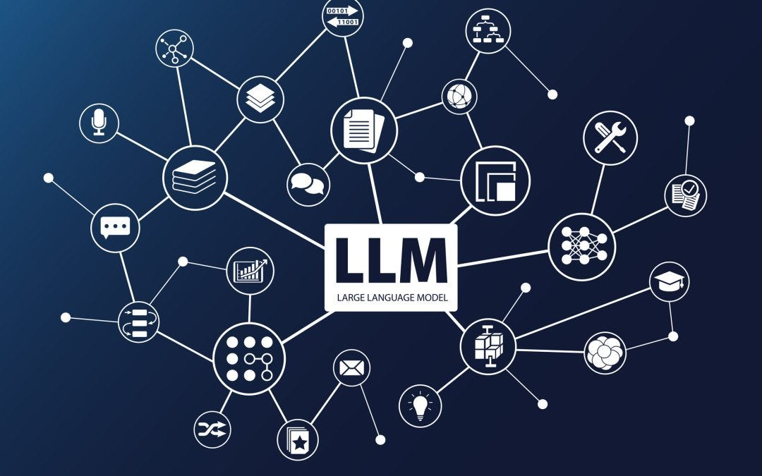
Opportunities of LLM Applications
Content Creation and Assistance
Customer Support and Chatbots
Language Translation and Localization
Educational Tools
Business Intelligence and Analytics
Accessibility for Disabled Persons
Coding and Development
Legal and Compliance Assistance
Healthcare Support
Art and Design Inspiration
Enhanced Search Engines
Crisis Management and Response
Notes:
K1: Types of middleware and their featur

Slide 18






Popular LLM
OpenAI ChatGPT
Google Germini
Anthropic Claude
Perplexity
Meta LLAMa
Mistral
Notes:
K3: Different types of platforms on which applications run

Slide 19

Use Cases of GAI in Finance
Automated Financial Reporting
Risk Assessment and Analysis
Algorithmic Trading Strategies
Fraud Detection and Prevention
Customer Service Chatbots
Personalized Financial Advice
Credit Scoring and Lending Analysis
Regulatory Compliance and Monitoring
Market Sentiment Analysis
Contract Review and Analysis
Notes:
K1, A1

Slide 20

Use Cases of GAI in Marketing
Content Creation
Market Research Analysis
Personalized Marketing
Email Marketing Automation
Social Media Management
SEO Optimization
Customer Sentiment Analysis
Chatbots for Customer Engagement
Predictive Analytics
Brand Strategy Development
Notes:
K1, A1

Slide 21

Use Cases of GAI in Education
Personalized Learning Assistance
Grading and Feedback Automation
Curriculum Development and Content Creation
Language Learning and Translation
Educational Chatbots
Research and Writing Assistance
Interactive Learning Environments
Special Education Support
Teacher Training and Professional Development
Student Engagement and Motivation Tools
Notes:
K1, A1

Slide 22

Use Cases of GAI in Healthcare
Drug discovery and development
Personalized medicine and treatment optimization
Medical imaging and diagnosis
Disease prediction and prevention
Biomarker development
Synthetic data generation for research
Robotic surgery
Virtual health assistants
Epidemiological research
Enhanced patient education and engagement
Genomic sequencing analysis
Automated clinical documentation
Notes:
K1, A1

Slide 23

Use Cases of GAI in Legal
Contract Analysis and Drafting
Legal Research Assistance
Document Review and Management
Litigation Support
Regulatory Compliance Monitoring
Intellectual Property Management
Legal Chatbots for Client Assistance
E-Discovery and Evidence Analysis
Risk Assessment and Management
Legal Education and Training
Notes:
K1, A1

Slide 24

Use Cases of GAI in HR
Resume Screening and Candidate Shortlisting
Employee Onboarding Automation
Training and Development Programs
Employee Engagement and Feedback Analysis
Policy and Compliance Documentation
Talent Management and Succession Planning
Internal Communication Enhancement
Performance Review and Feedback Generation
Diversity and Inclusion Initiative Support
Conflict Resolution and Mediation Assistance
Notes:
K1, A1

Slide 25

Use Cases of GAI in eCommerce
Product Description Generation
Customer Service Chatbots
Personalized Product Recommendations
Review and Feedback Analysis
Market Trend Analysis
Inventory and Supply Chain Management
Pricing Strategy Optimization
Email Marketing and Engagement
Social Media Content Creation
Fraud Detection and Prevention
Notes:
K1, A1

Slide 26
LLM Training
Untrained
Large Language Model
Large Data Source
Wikipedia
Crawl Internet
Other sources eg ebooks…
Text Output

Slide 27
LLM Inference
Trained Large Language Model
Prompt
Text Output

Slide 28
LLM Autoregressive Model
The output is different each time
Media
Health
"Singapore Press Holdings (SPH) is a leading"
GPT
Sport.
"Media"
Organization
School
GPT
"Singapore Press Holdings (SPH) is a leading media"
Company
"Organization "
Notes:
What is GPT?

Slide 29
LLM Autoregressive Model
Roses
Are
Red
Violets
Are
Blue

Slide 30
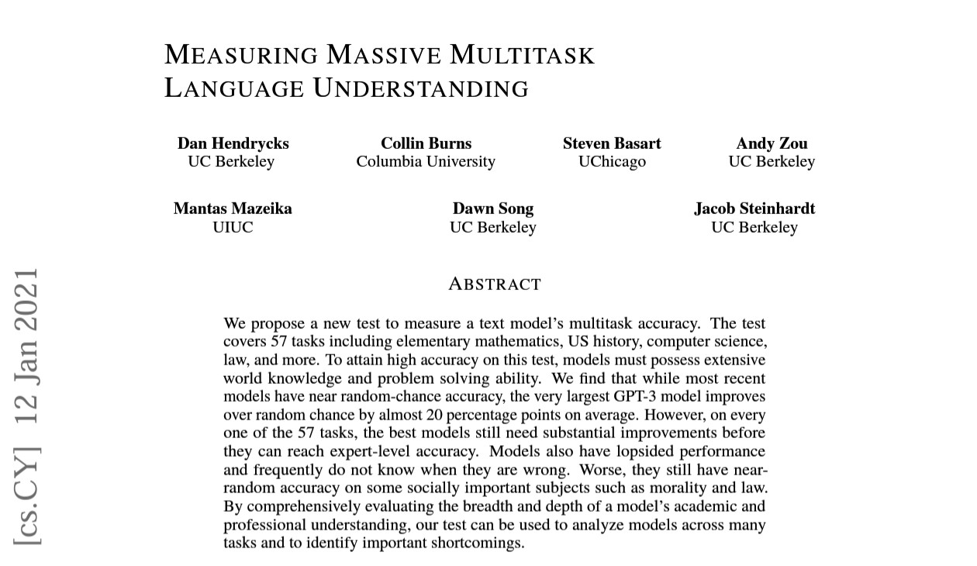
MMLU Benchmark
Notes:
K1: Types of middleware and their featur

Slide 31
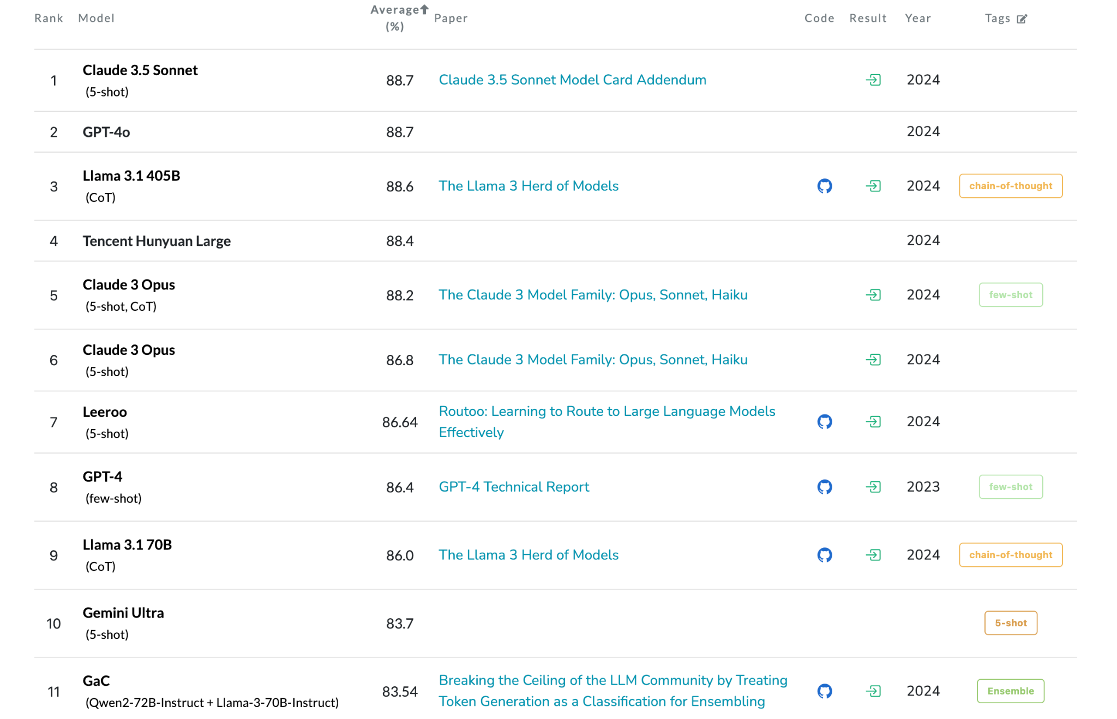
MMLU Benchmark on LLMs
Source: https://paperswithcode.com/sota/multi-task-language-understanding-on-mmlu
Notes:
K1: Types of middleware and their featur

Slide 32
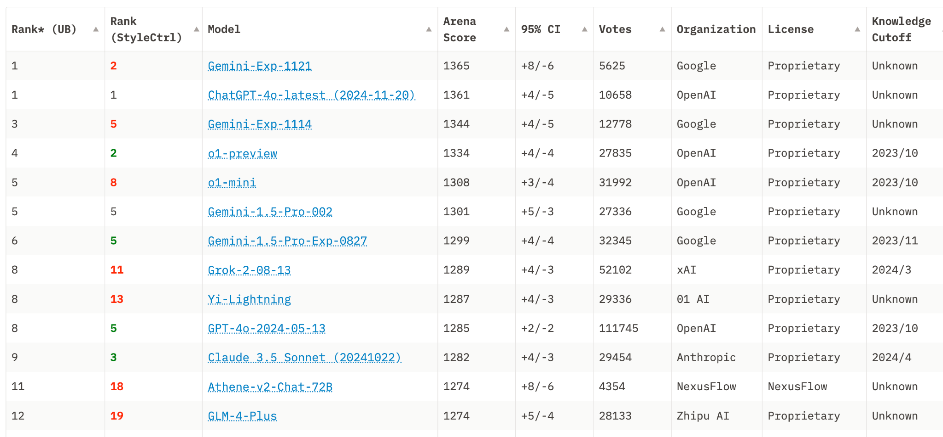
Elo Ranking on LLMs
Source: https://huggingface.co/spaces/lmsys/chatbot-arena-leaderboard
Notes:
K1: Types of middleware and their featur

Slide 33

What is Gemini
Gemini, a multimodal model from Google DeepMind.
Gemini is built from the ground up for multimodality—reasoning across text, images, video and code.

Slide 34

Notes:
https://youtu.be/SSnsmqIj1MI?si=i8DggRu0WX8rDBDX

Slide 35
Gemini Models
Gemini is a family of models, which consists of:
Ultra
Pro
Flash
Nano

Slide 36
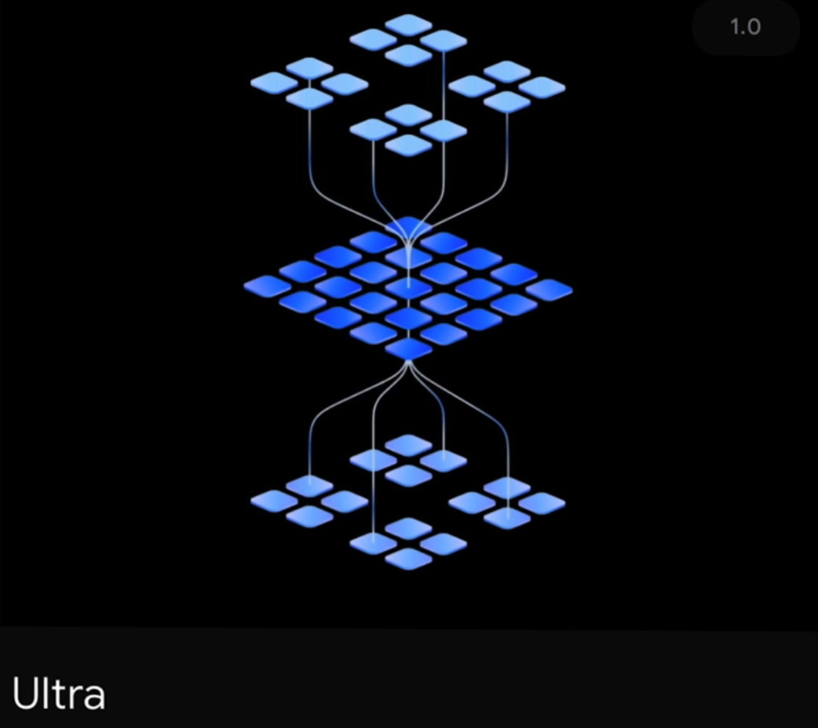
Ultra
The most capable model that delivers state-of-the-art performance across a wide range of highly complex tasks”
Excels at reasoning and multimodal tasks.
Our largest and most capable model for highly complex tasks.
Gemini Ultra is currently undergoing trust and safety checks, fine tuning, and model refinement.
Will eventually be available to“
select customers developers, partners and safety and responsibility experts for early experimentation and feedback”

Slide 37
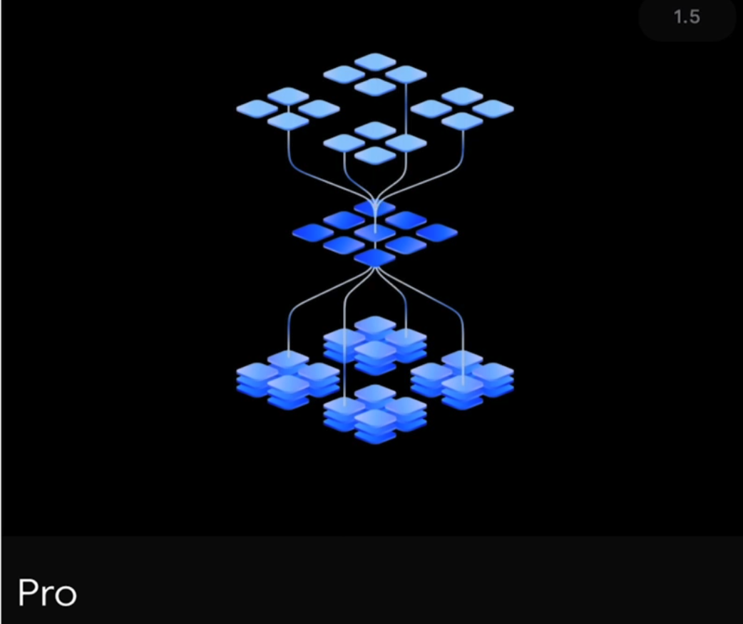
Pro
The mid-tier option
A model optimized for performance, cost, and latency
Does well across a wide range of tasks: strong reasoning andbroad multimodal capabilities.
“our best model for scaling across a wide range of tasks“
Eventually Gemini Pro will be available in Google products like Search, Ads, Chrome and Duet AI.

Slide 38
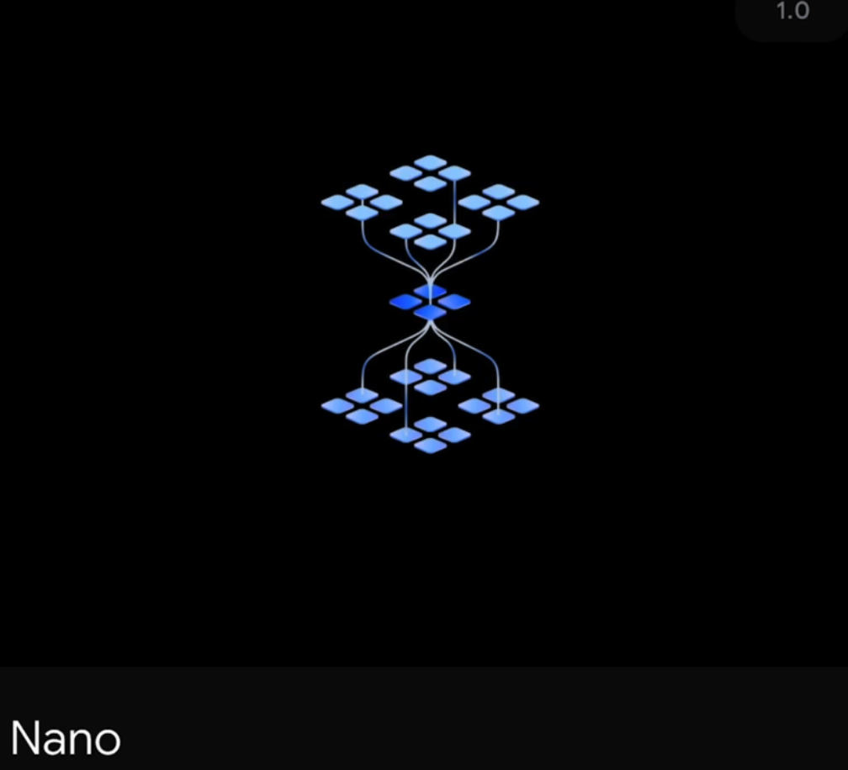
Nano
The most efficient model,
designed to run on mobile
devices.
Google trained two versions of
Nano, with 1.8B (Nano-1) and
3.25B (Nano-2) parameters,
targeting low and high memory
devices respectively.
Android developers can build with Gemini Nano for on-device tasks,

Slide 39
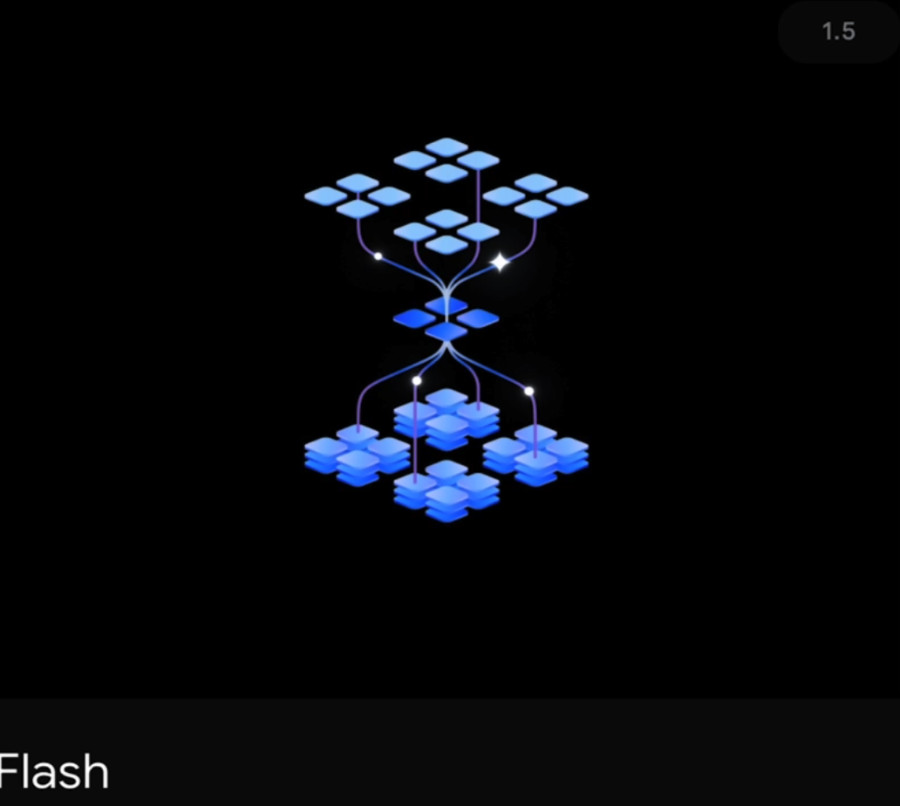
Flash
Lightweight model, optimized for speed and efficiency.

Slide 40
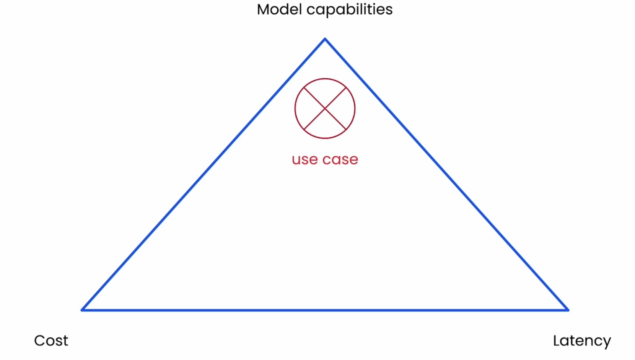
How to Choose?

Slide 41
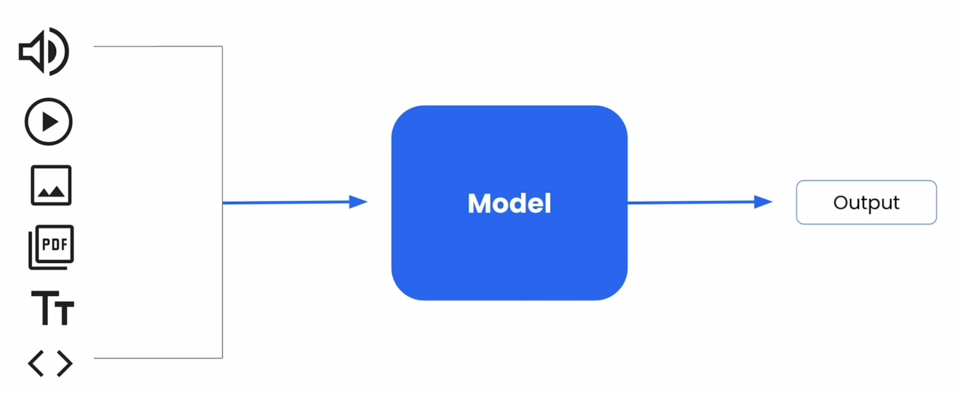
Multimodal
Inputs can be a mix of code, text, pdf, image, video and audio.

Slide 42
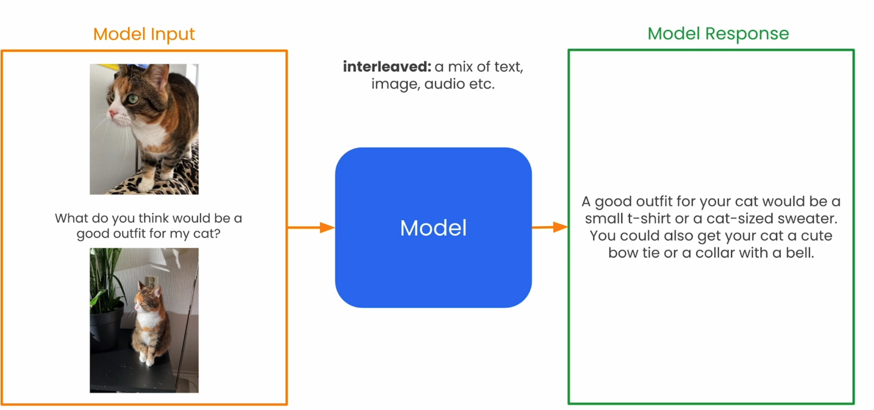
Interleaved Inputs and Response

Slide 43
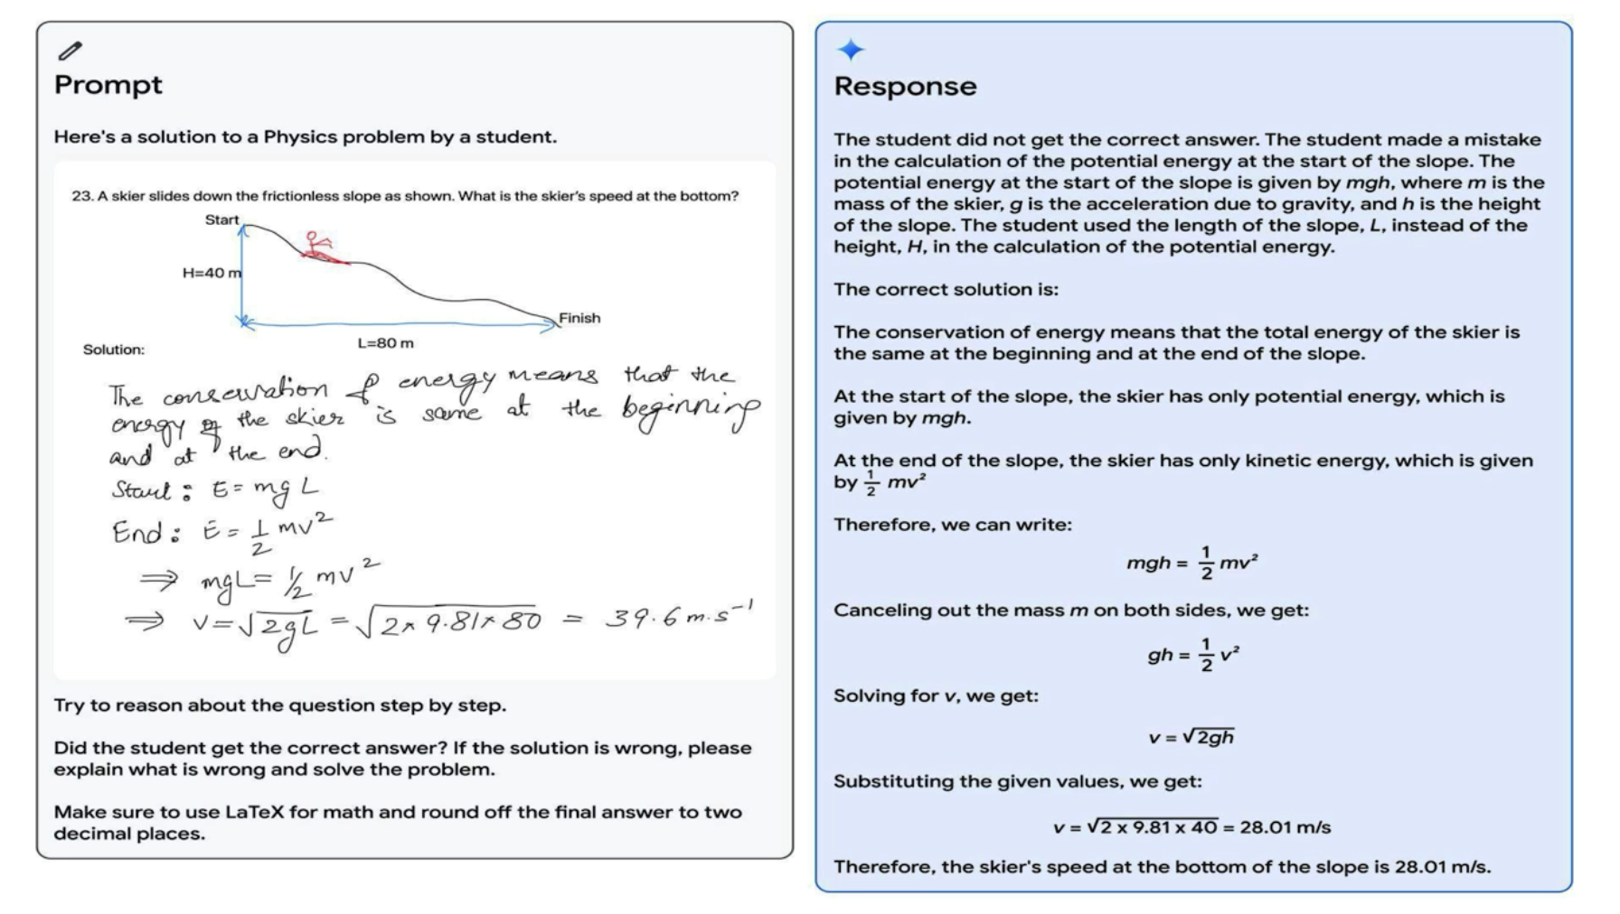
Cross Modal Reasoning

Slide 44
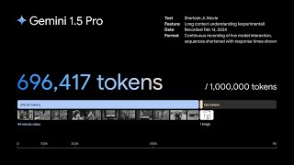

Slide 45
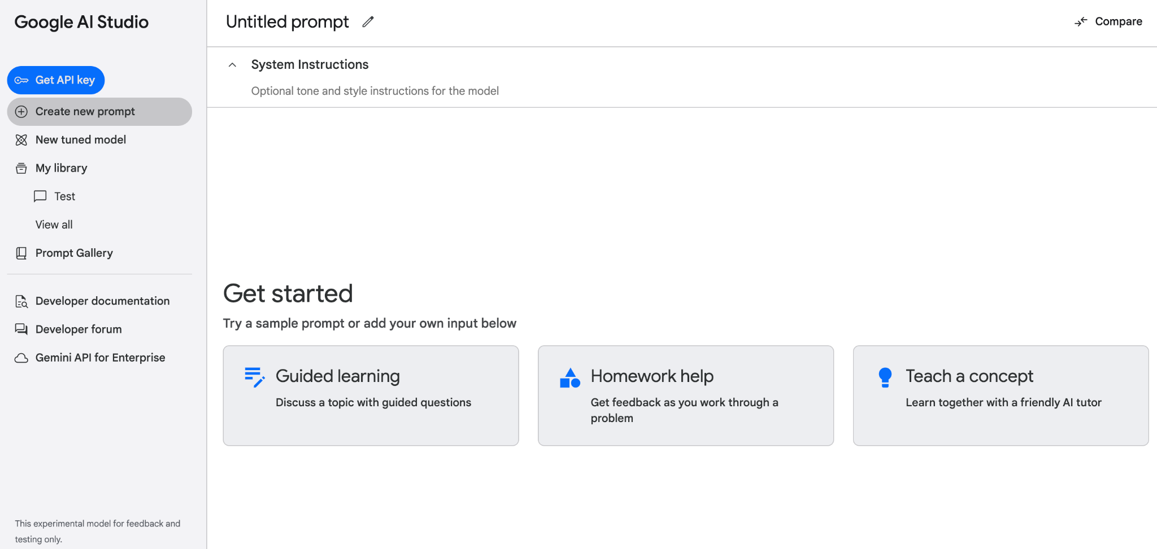
Google AI Studio
Browser Based IDE
Made for Prototyping
Try Out Models and Experiment
Supports Gemini Pro & Vision Pro
You can Export to Code
Completely Free!

Slide 46
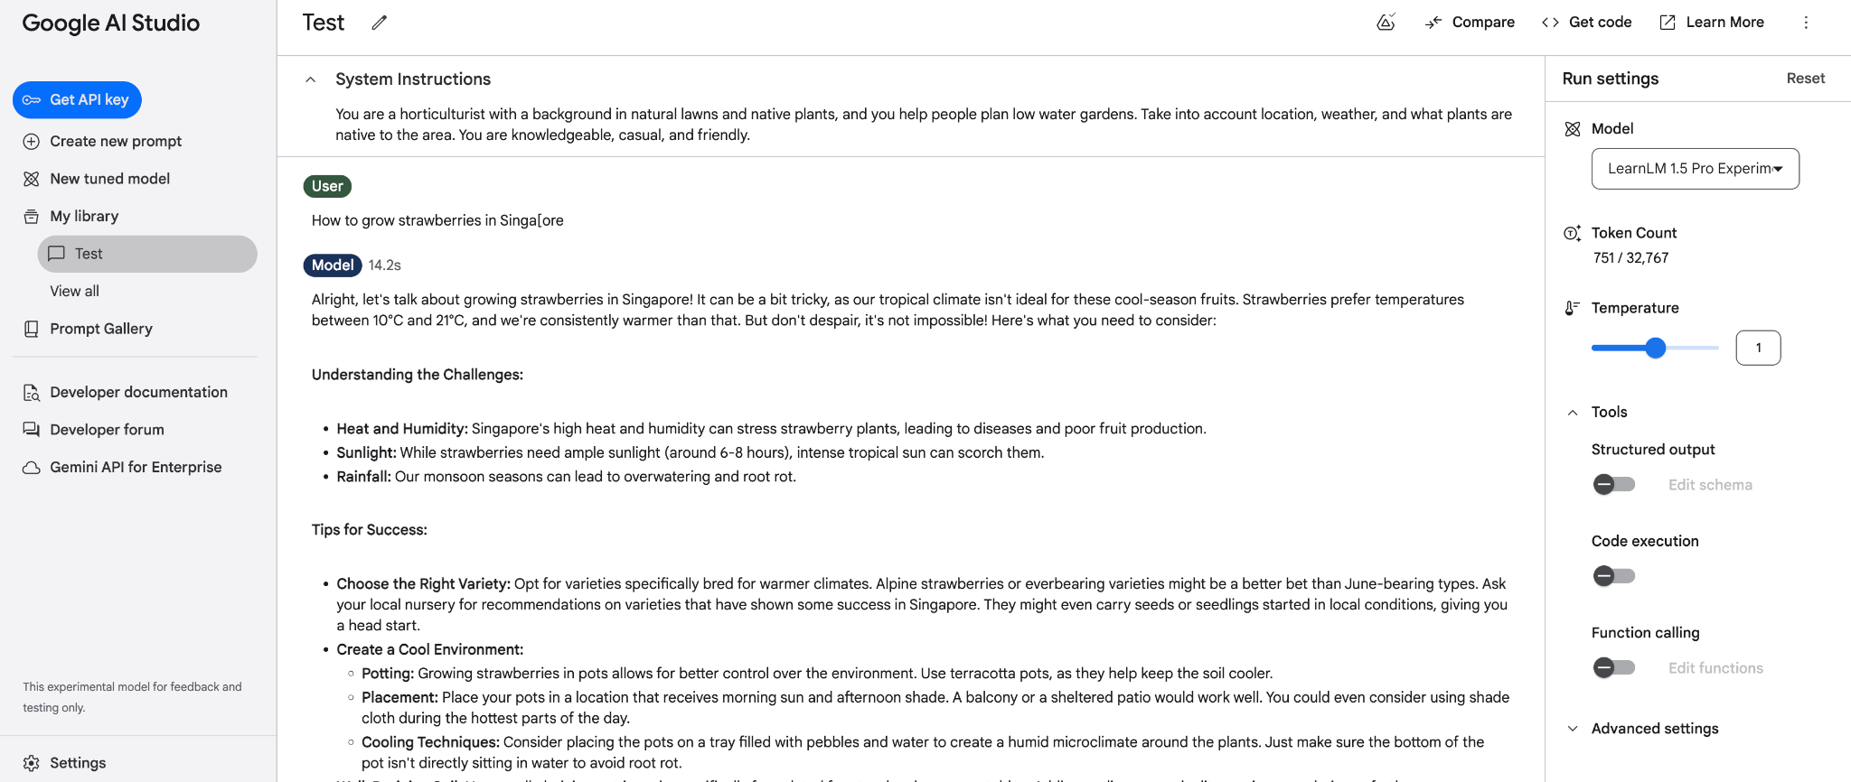
Text Prompt on Google AI Studio

Slide 47
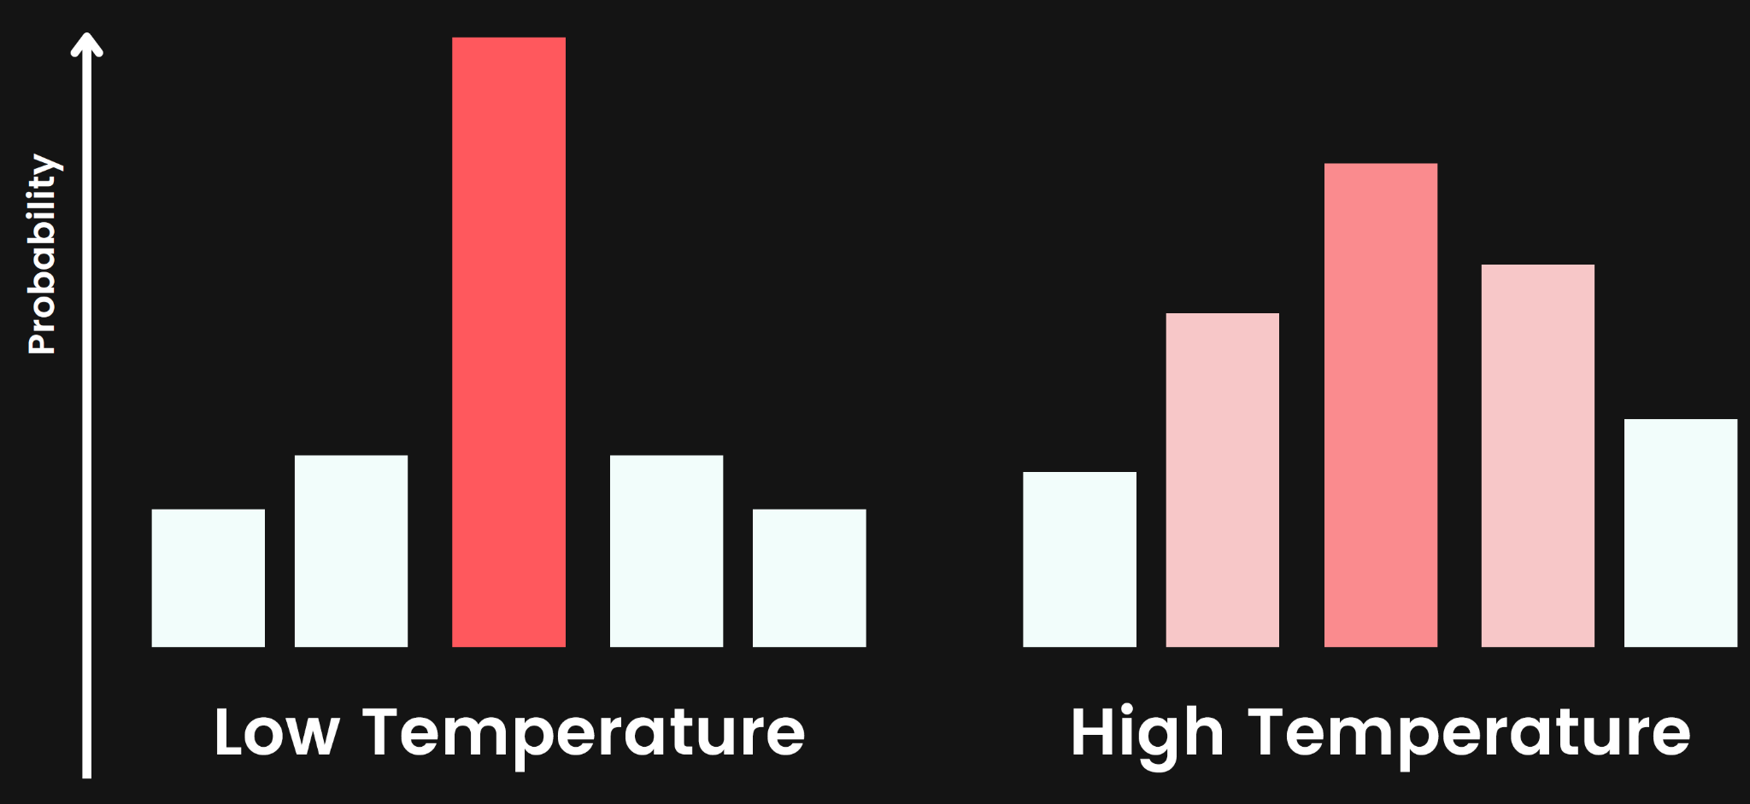
Temperature

Slide 48
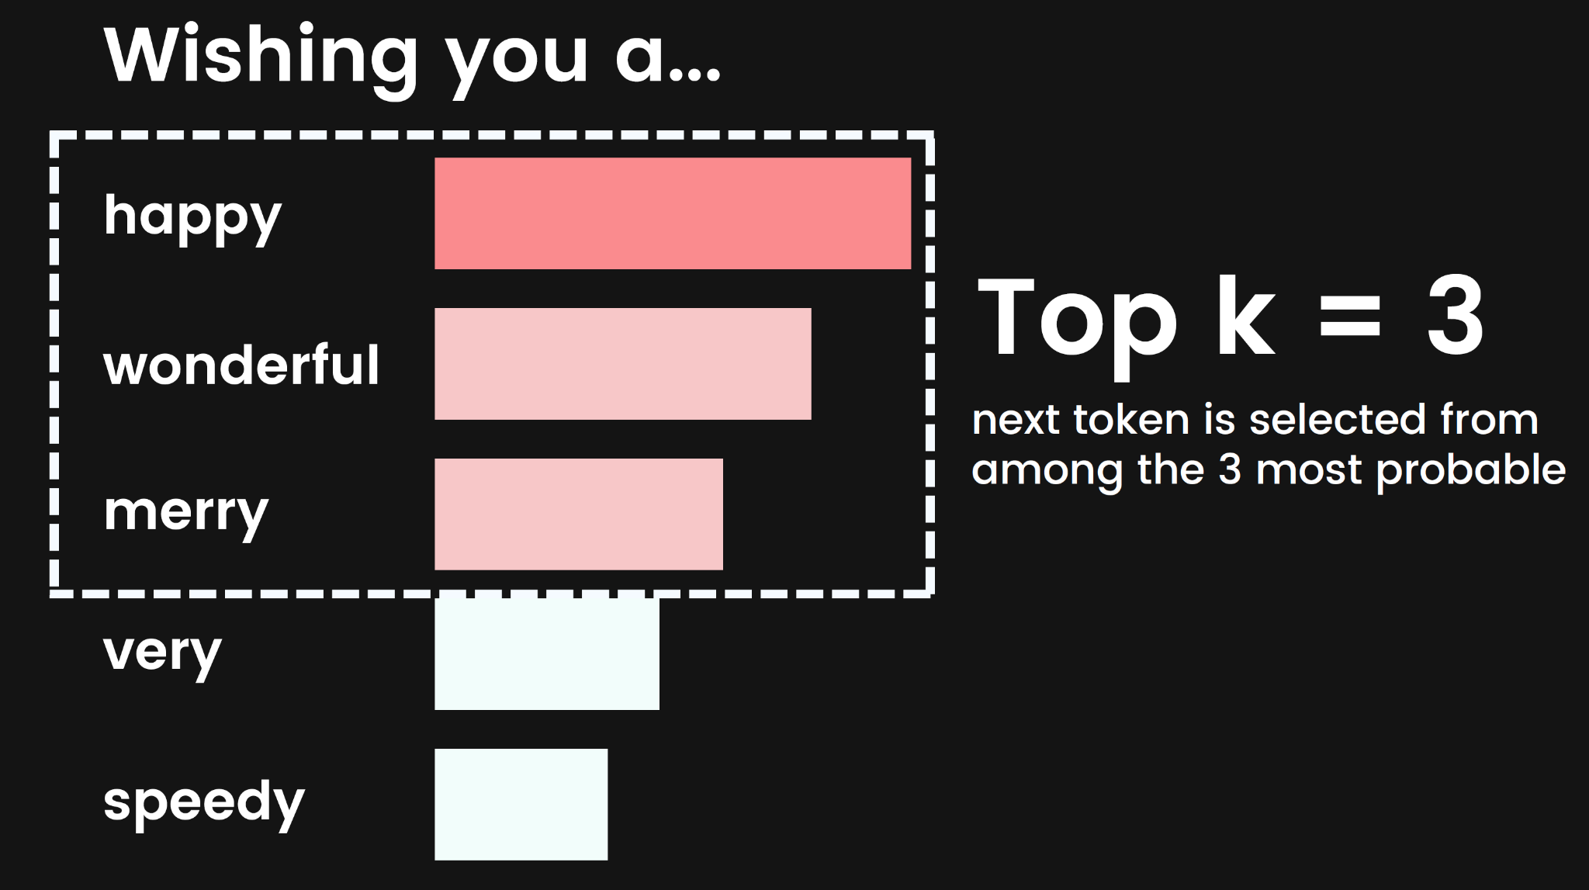
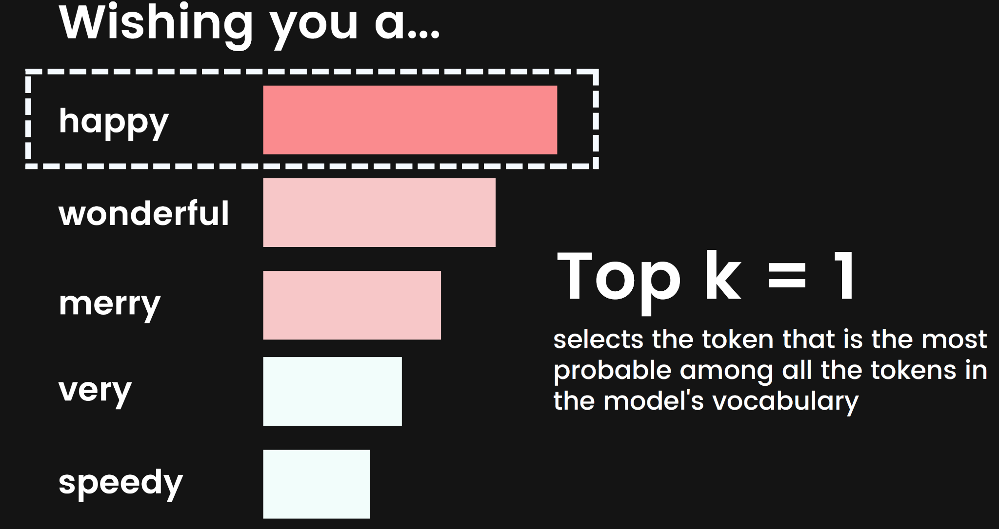
Top K
A topK of 1 means that the model selects the token that is the most probable among all the tokens in the model's vocabulary
A topK of 3 means that the next token is selected from among the 3 most probable using the temperature.
For each token selection step, the topK tokens with the highest probabilities are sampled.
Tokens are then further filtered based on topP with the final token selected using temperature sampling.
Range: 1-40
Default for gemini-pro: 1
Default for gemini-pro-vision: 32

Slide 49
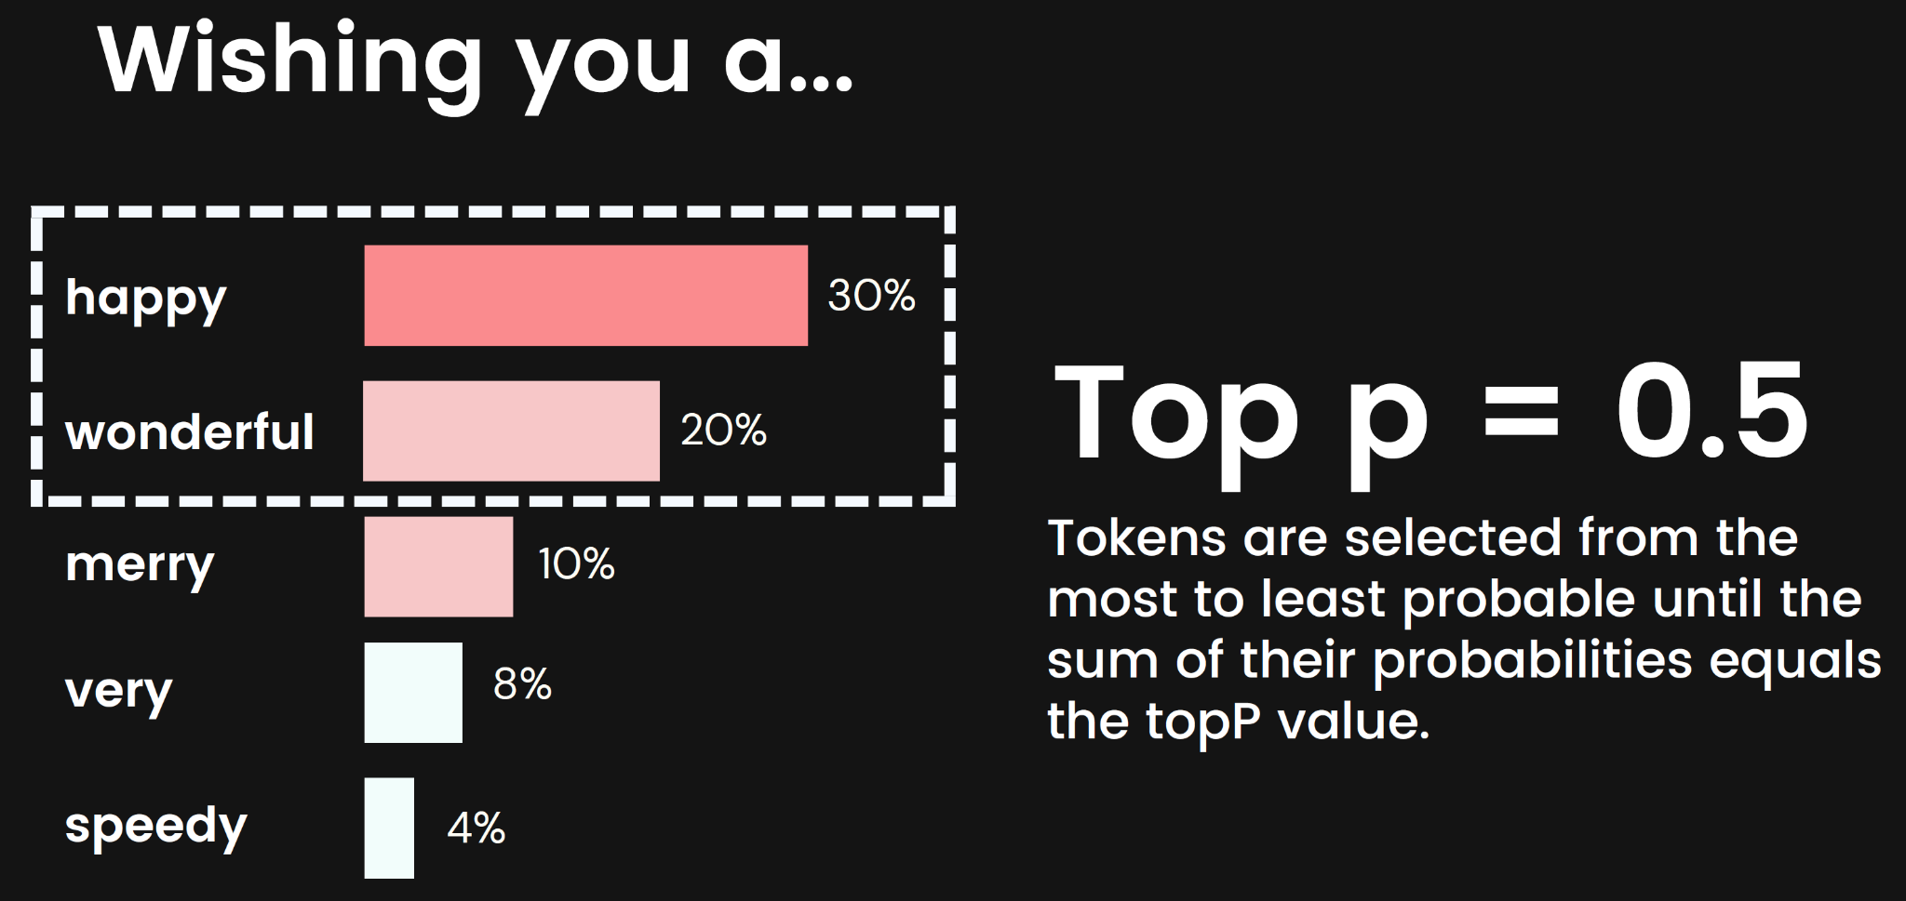
Top P
Picks from the top tokens based on thesum of their probabilities
Tokens are selected from the most to least probable until the sum of their probabilities equals the topP value.
For example, if tokens A, B, and C have a probability of 0.3, 0.2,and 0.1 and the topP value is 0.5, then the model will select either A or B as the next token by using the temperature andexclude C as a candidate.
The default top P value is 0.95 (docs are inconsistent here)
Range: 0.0 - 1.0

Slide 50
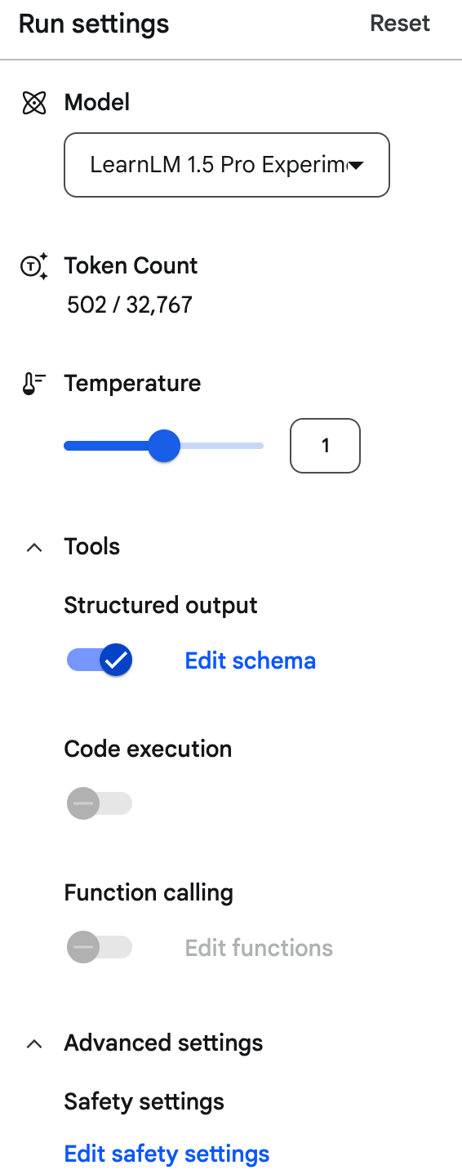
Default Parameter Values
For Gemini Pro Vision (Gemini 1.0 Pro Vision) are:
Temperature
Default: 0.4
Range: [0.0, 1.0]
Top k
Default: None
Range: [1, 40]
Top p
Default: 1.0
Range: [0.0, 1.0]

Slide 51
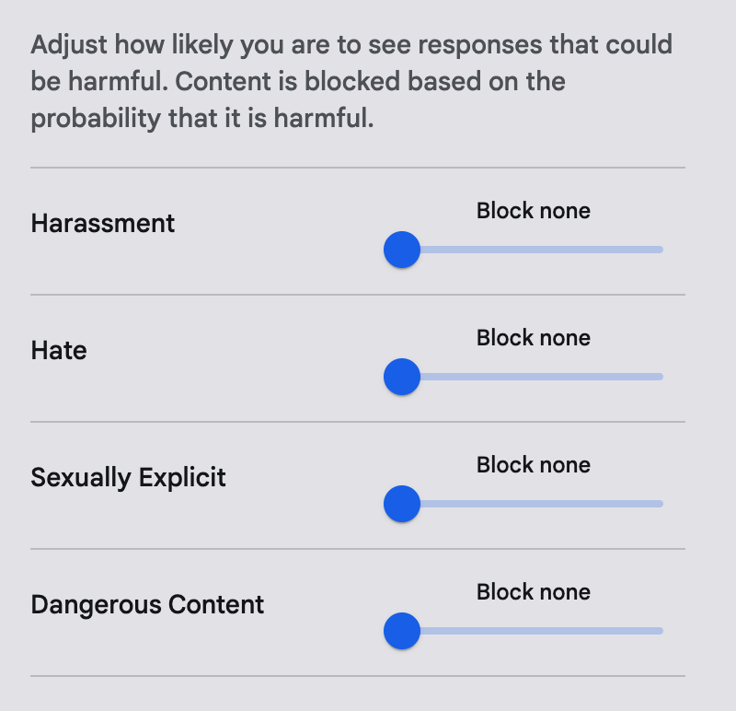
Safety Setting

Slide 52
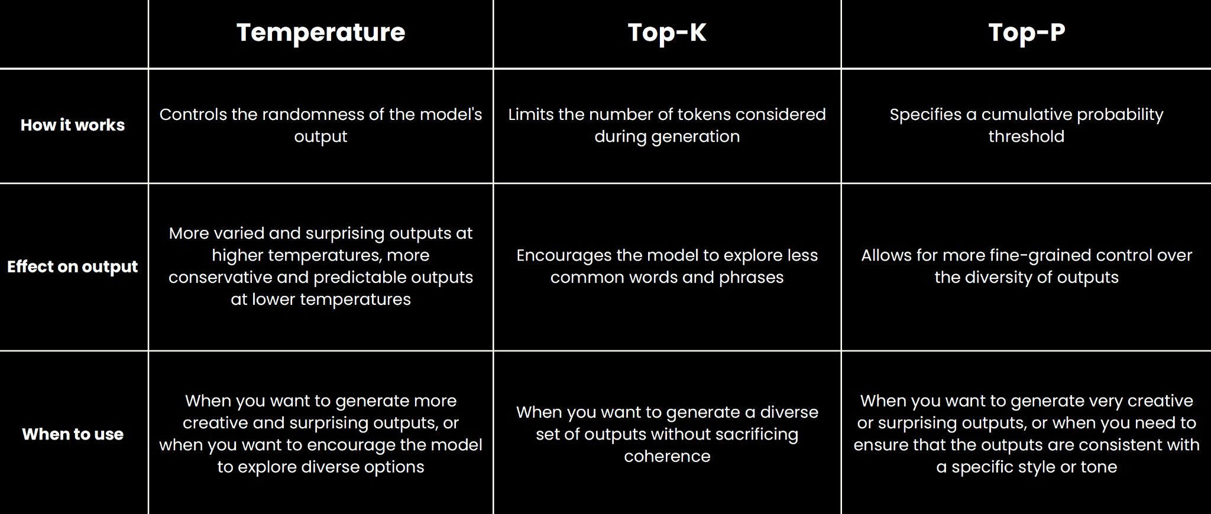
Comparison of Parameters

Slide 53
Activity: Google AI Studio
Try out Google AI studio at
https://aistudio.google.com/prompts/new_chat
Adjust the parameters and safety setting, and observe the impact on the outputs.
Notes:
A2: Perform feasibility scan and assessment to identify potential middleware to be used

Slide 54
Topic 2
Multimodal Prompting with Gemini Pro LLM

Slide 55
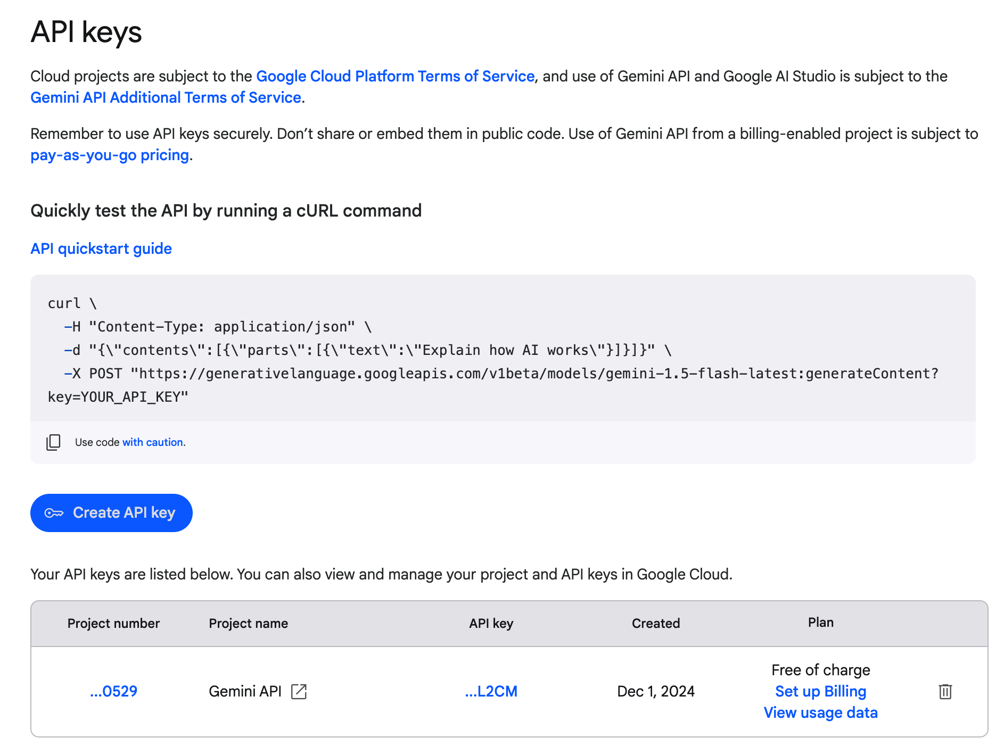
Google AI Studio API Key
Notes:
A2: Perform feasibility scan and assessment to identify potential middleware to be used
https://aistudio.google.com/app/u/1/prompts/new_chat

Slide 56
Gemini API Pricing
Free for everyone
Rate Limits: 60 QPM (queries per minute)
Price (input): Free
Price (output): Free
Input/output data used to improve our products: Yes
Get API key in Google AI Studio
Pay-as-you-go
Rate Limits: Starts at 60 QPM
Price (input):
$0.00025 / 1K characters
$0.0025 / image
Price (output): $0.0005 / 1K char
Input/output data used to improve our products: No
Coming soon to Google AI Studio

Slide 57
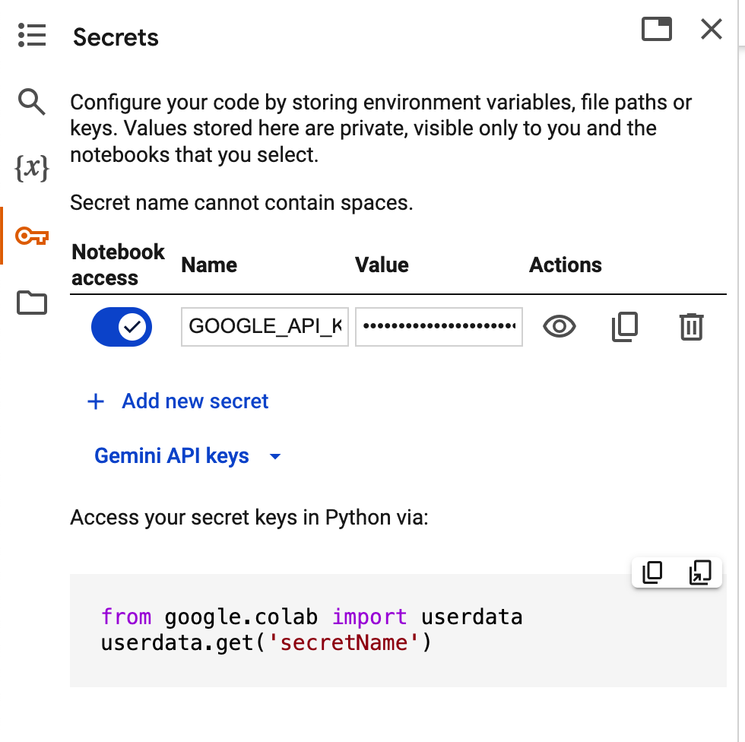
Import API Key to Colab
Notes:
A2: Perform feasibility scan and assessment to identify potential middleware to be used
https://aistudio.google.com/app/u/1/prompts/new_chat

Slide 58
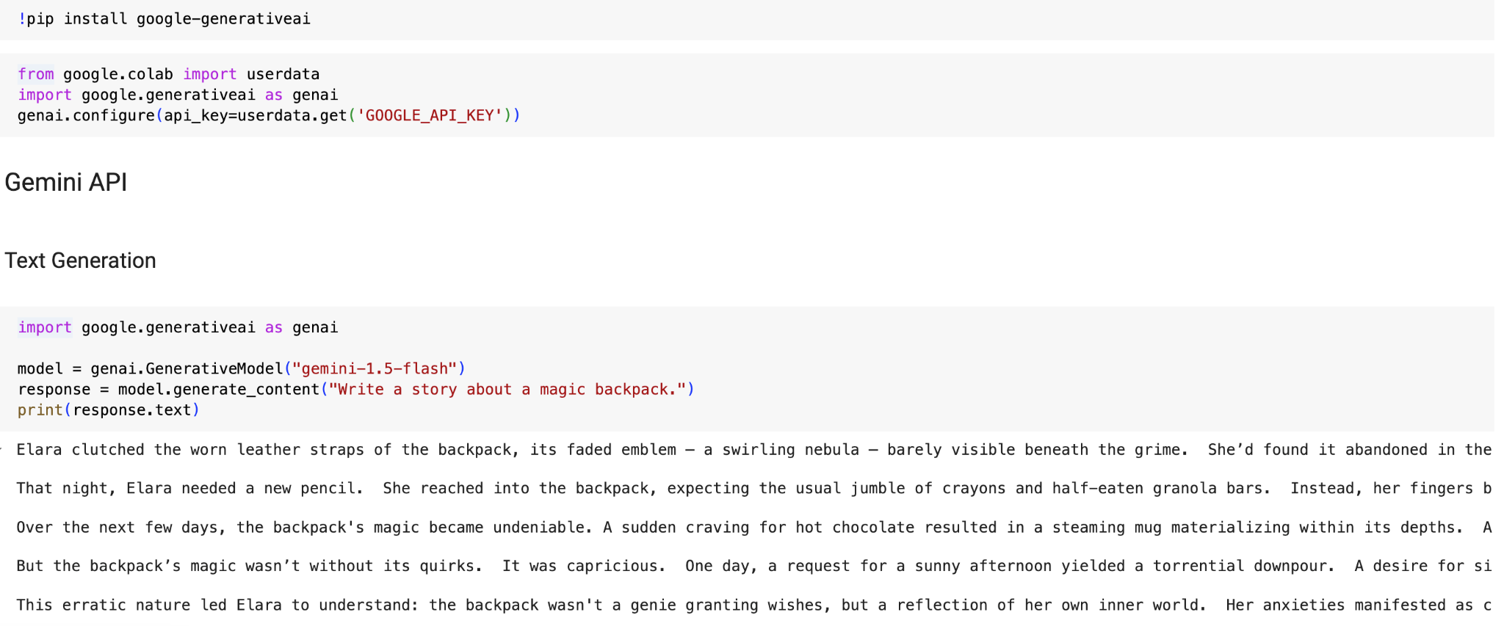
Test Google AI API
Notes:
A2: Perform feasibility scan and assessment to identify potential middleware to be used

Slide 59
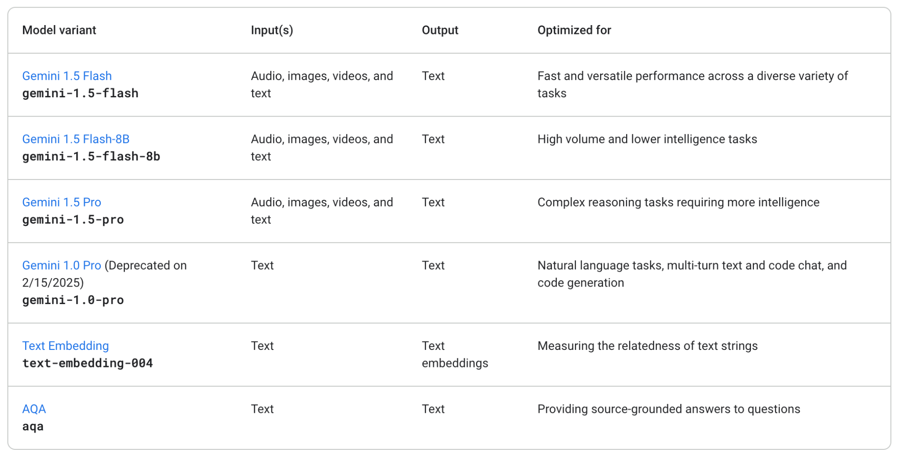
Gemini API
Source: https://ai.google.dev/gemini-api/docs/models/gemini

Slide 60
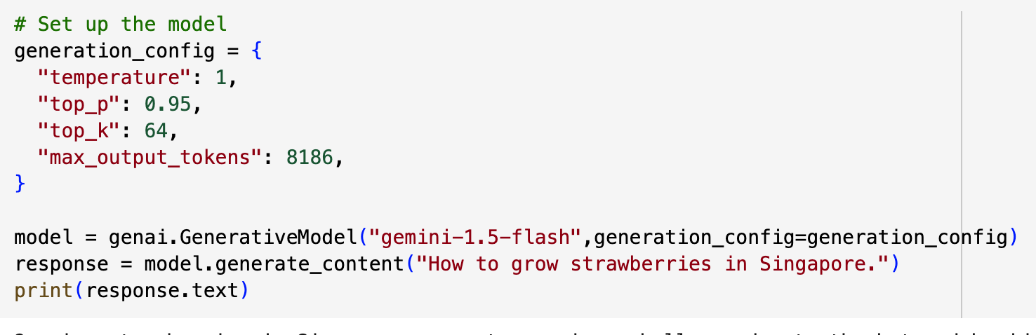
Configure Gemini Model
Notes:
A2: Perform feasibility scan and assessment to identify potential middleware to be used

Slide 61
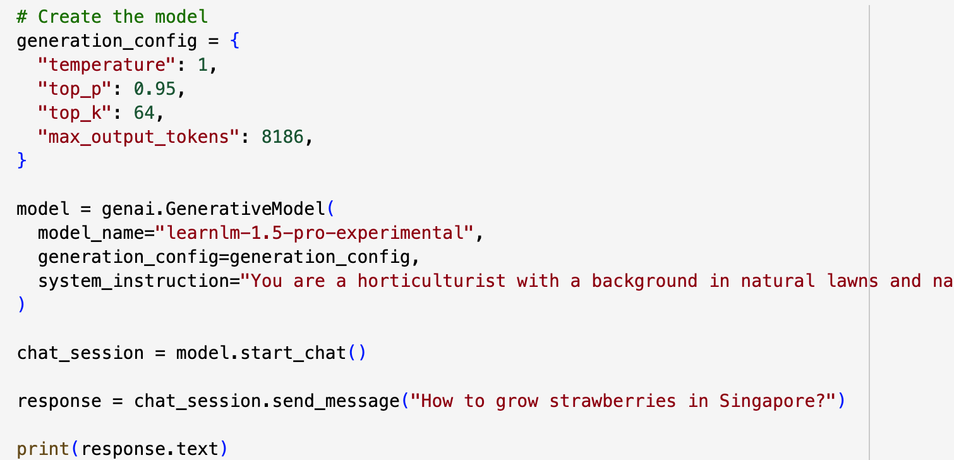
Chat
Notes:
A2: Perform feasibility scan and assessment to identify potential middleware to be used

Slide 62
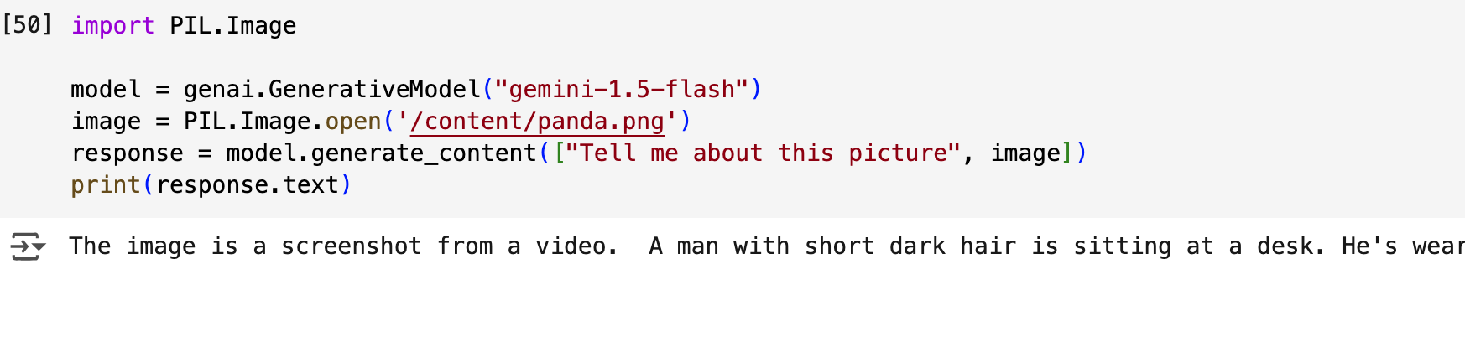
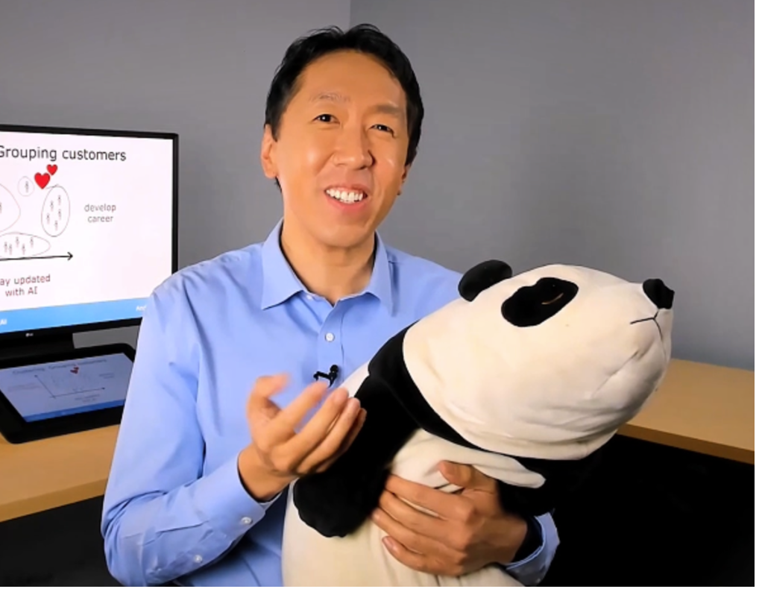
Multimodality: Image + Text

Slide 63
Activity: Gemini API
Import your own image
Prompt the Gemini API to describe your image
Notes:
A2: Perform feasibility scan and assessment to identify potential middleware to be used

Slide 64
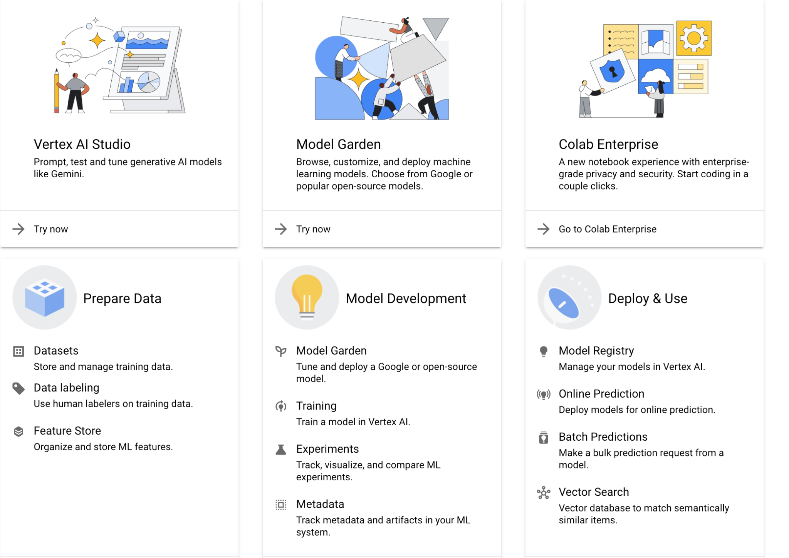
What is Google Vertex AI?
Enterprise-Grade
Access to many more models
Integrated With Google Cloud
Features For Developing Models
Features For Deploying Models
Pay As You Go Pricing

Slide 65
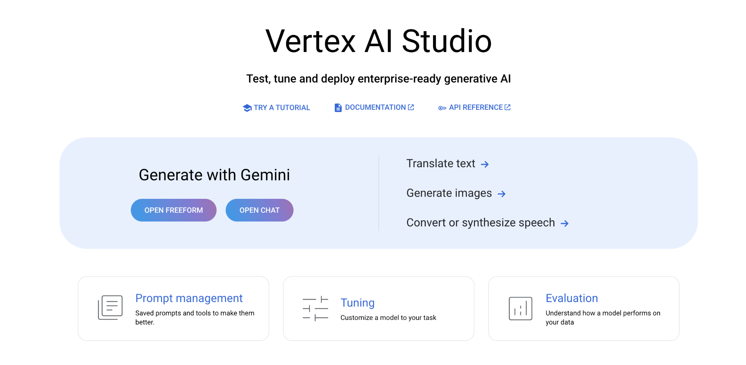
What is Vertex AI Studio?

Slide 66
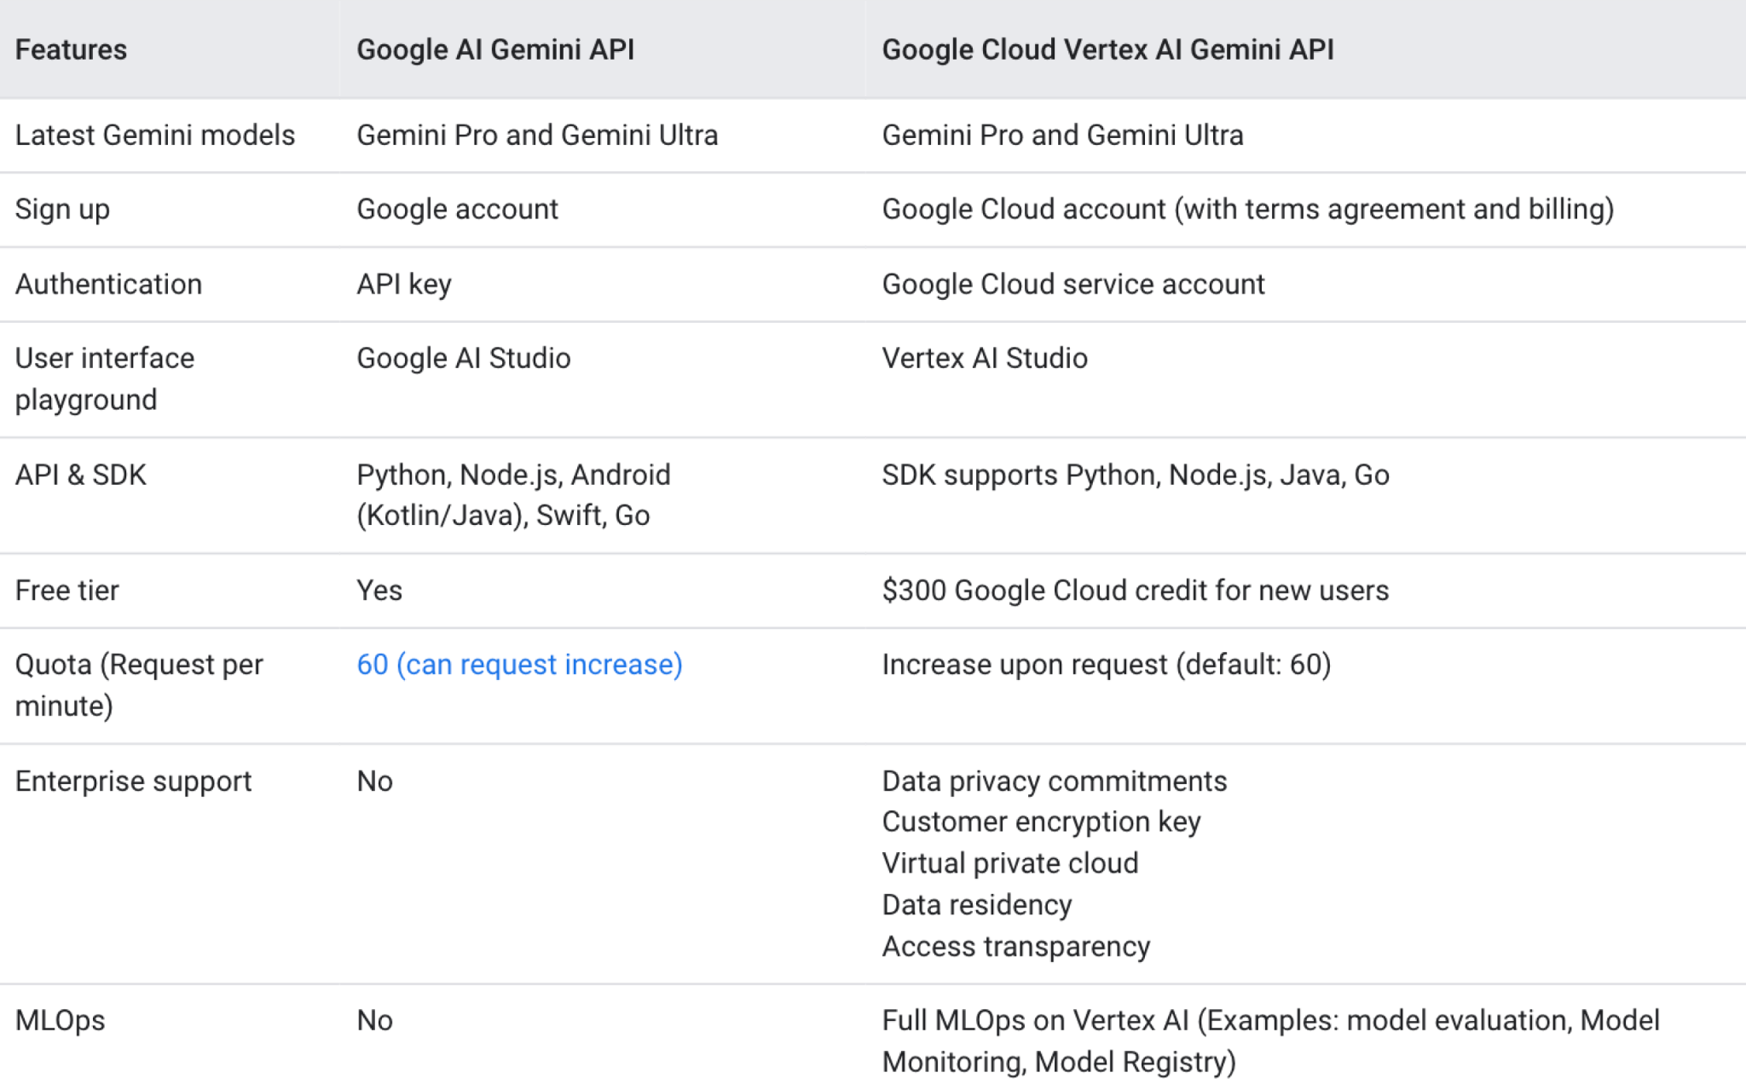
Gemini vs Vertex AI API

Slide 67
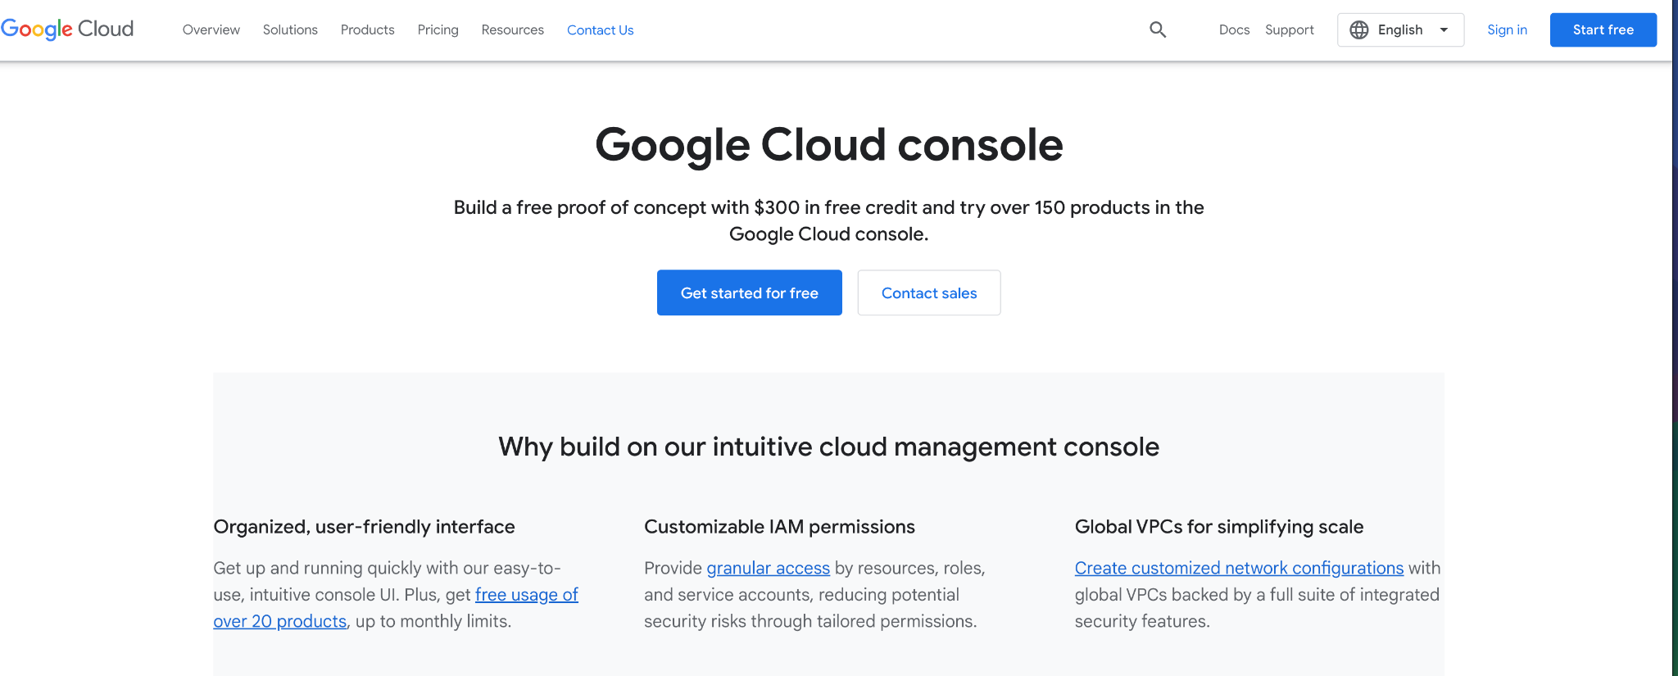
Setup Google Cloud Free Trial

Slide 68
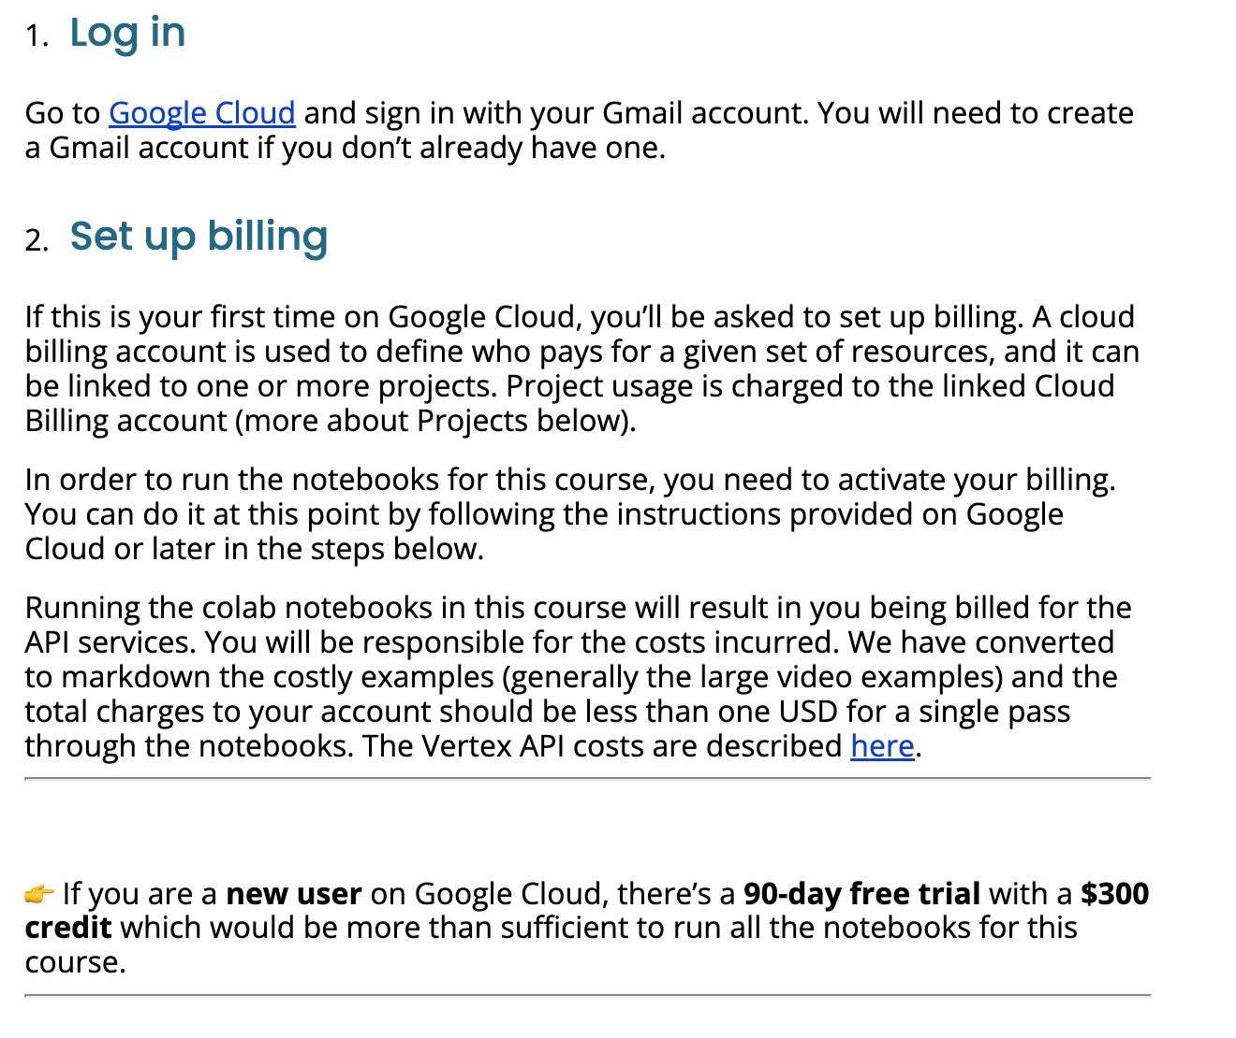
Setup Google Cloud

Slide 69
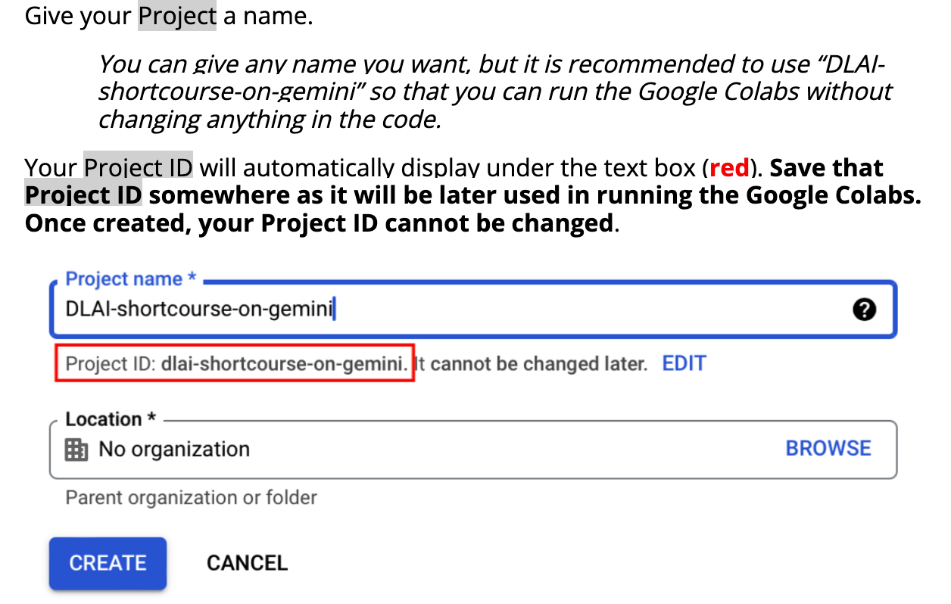
Setup Google Cloud

Slide 70
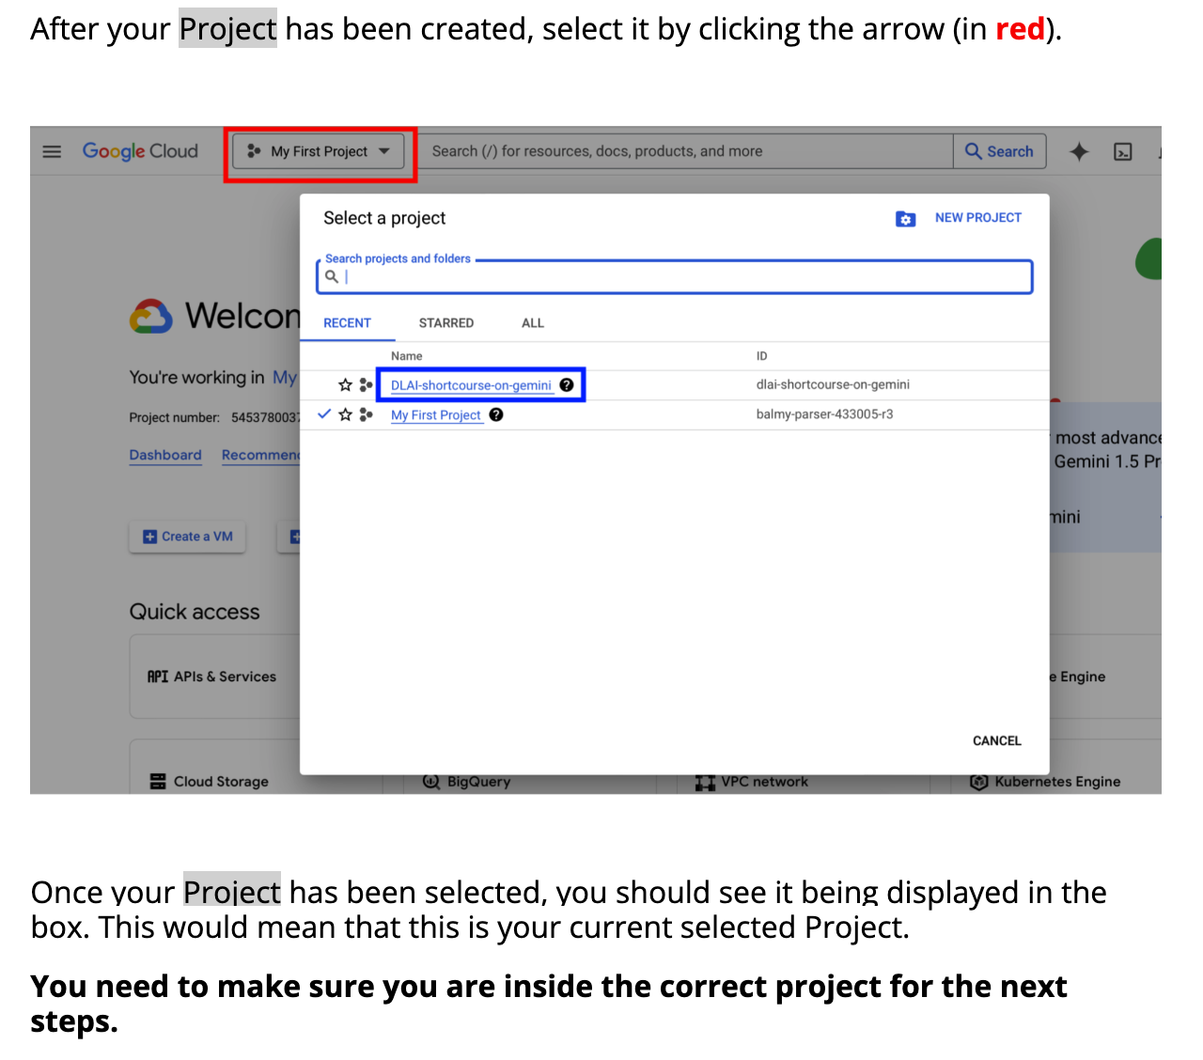
Setup Google Cloud

Slide 71
Setup Google Cloud

Slide 72
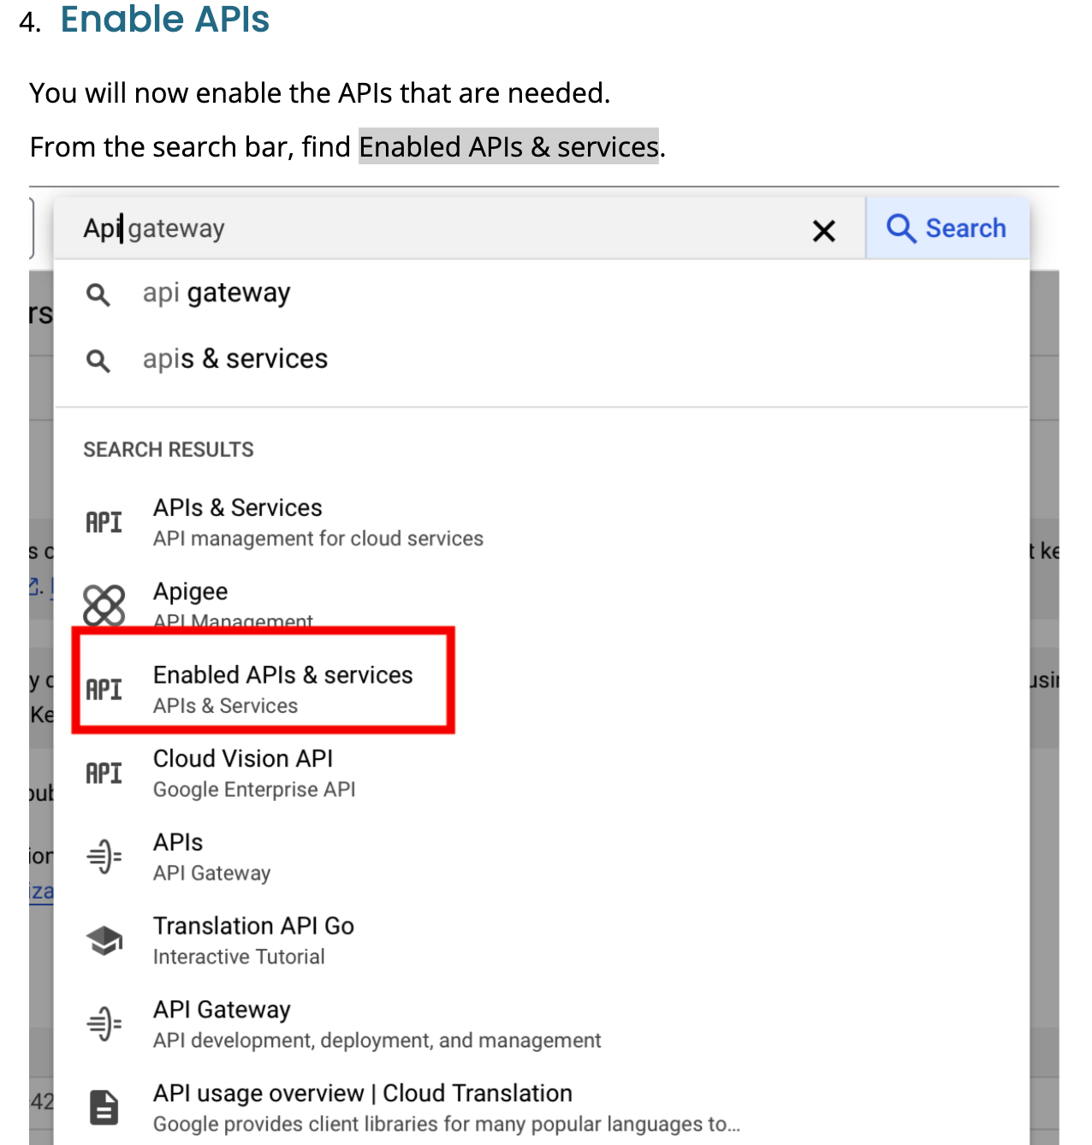
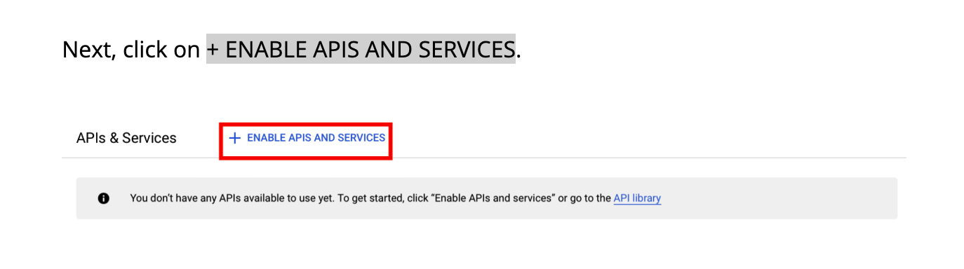
Setup Google Cloud

Slide 73
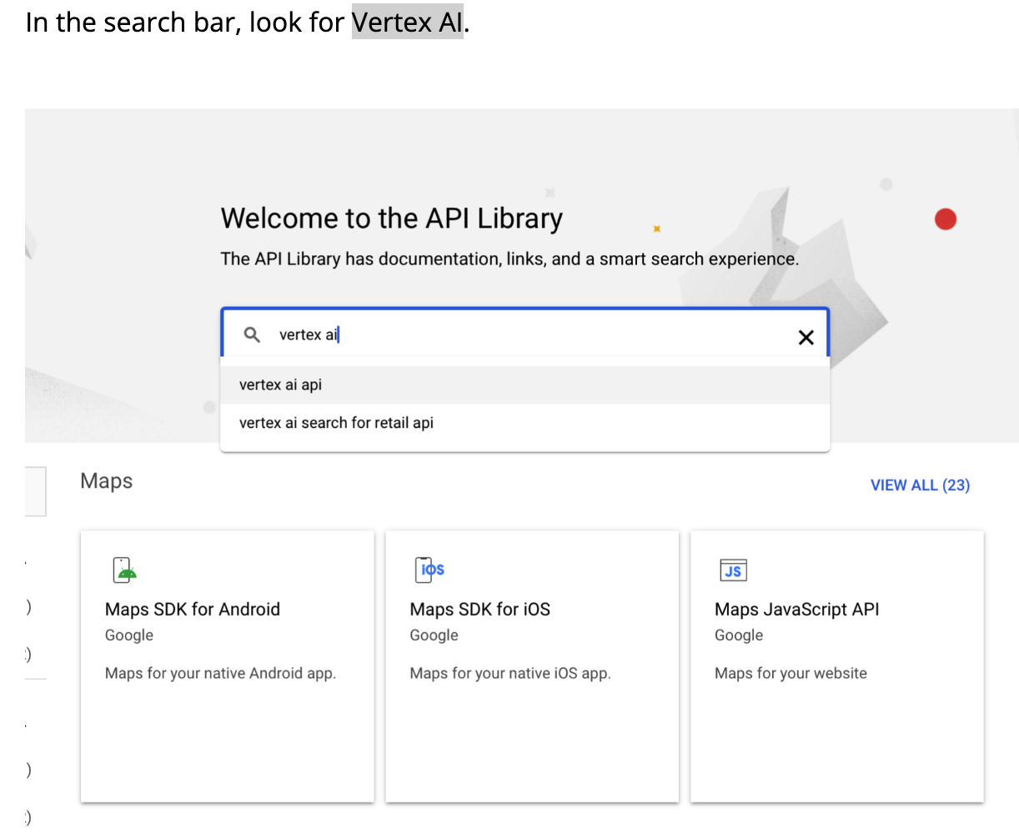
Setup Google Cloud

Slide 74
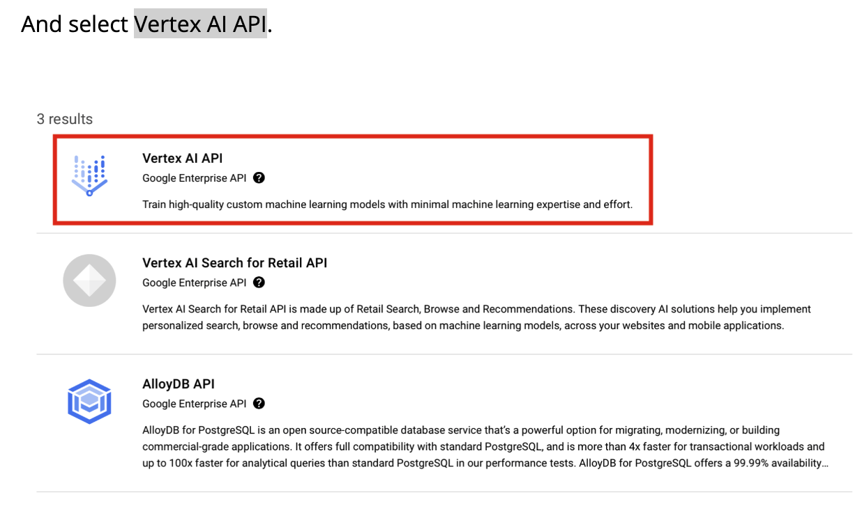
Setup Google Cloud

Slide 75
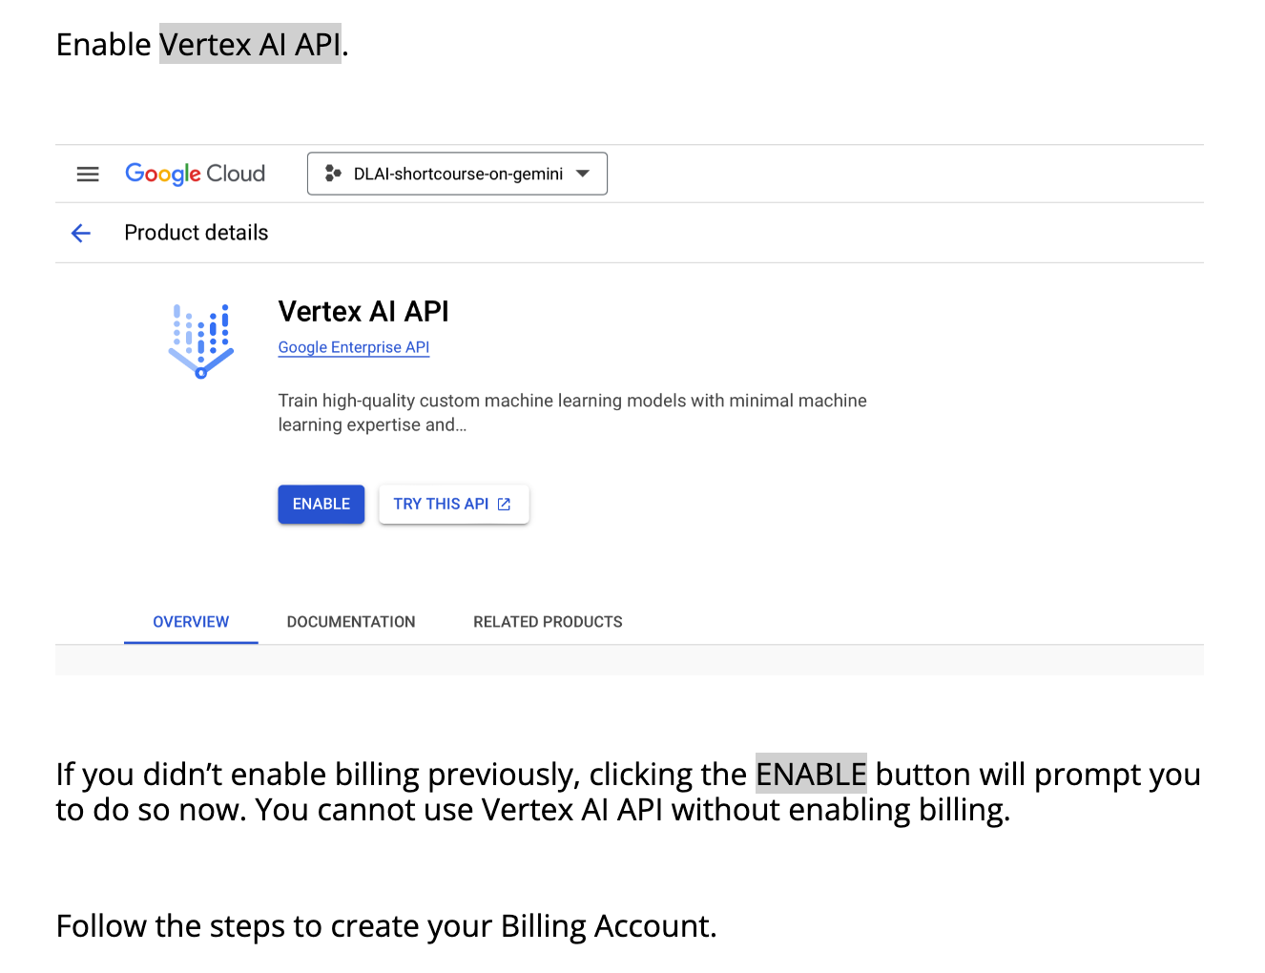
Setup Google Cloud

Slide 76
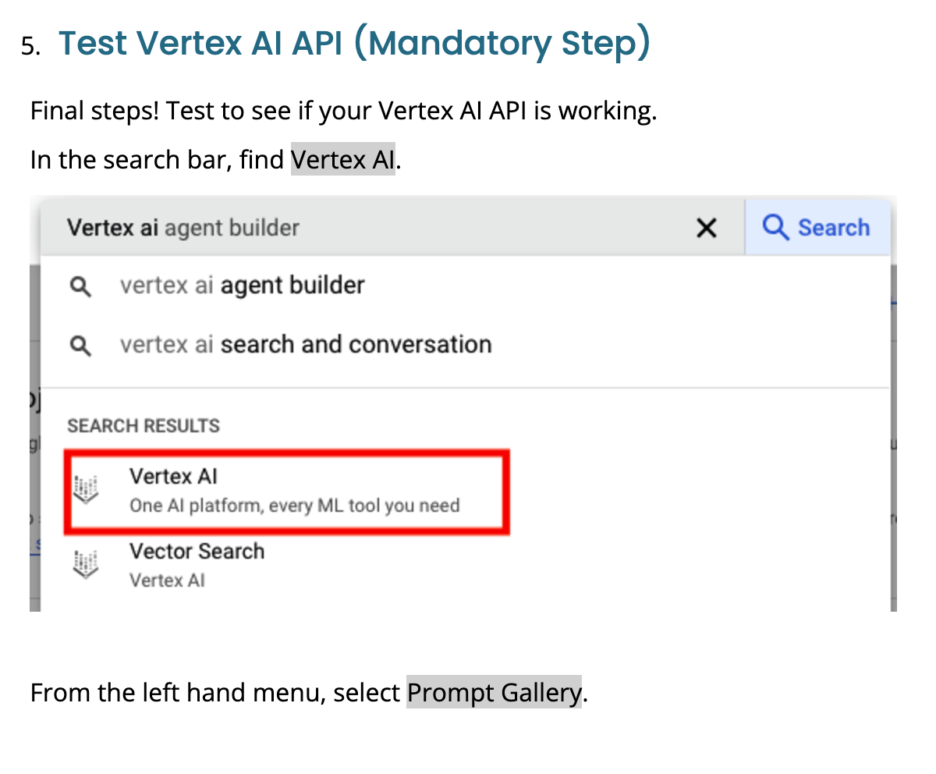
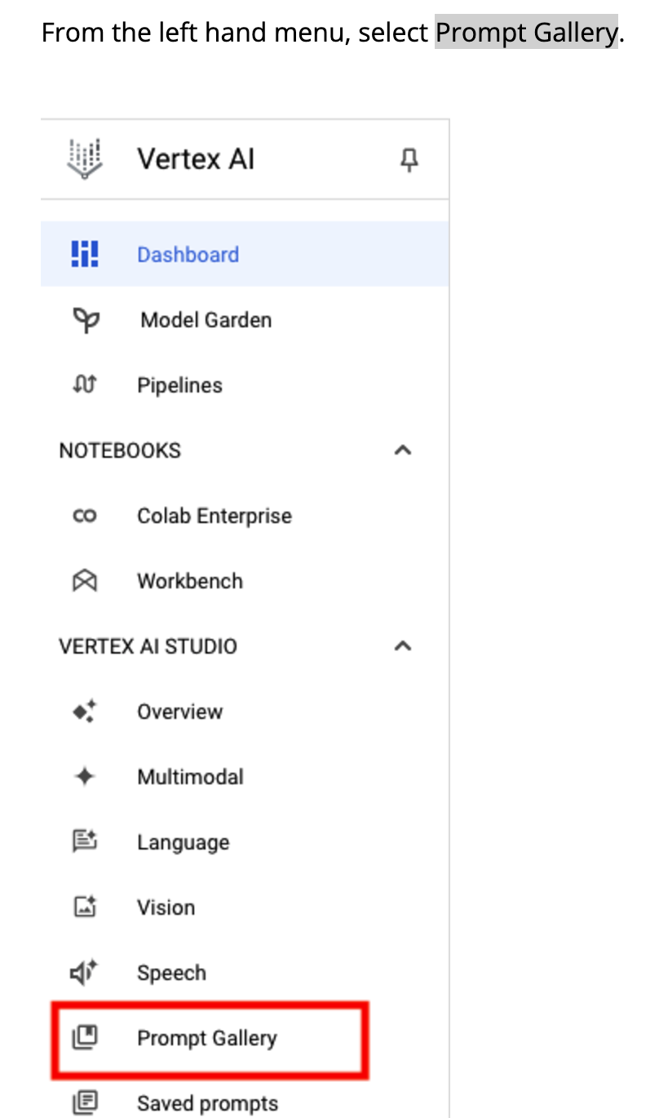
Setup Google Cloud

Slide 77
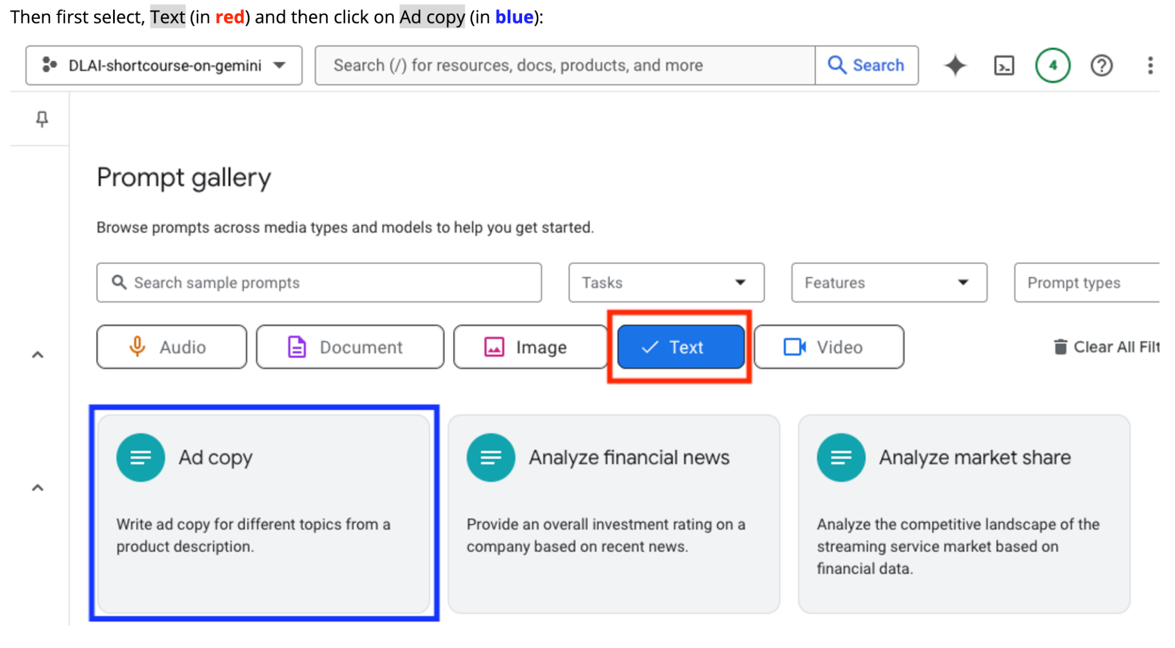
Setup Google Cloud

Slide 78
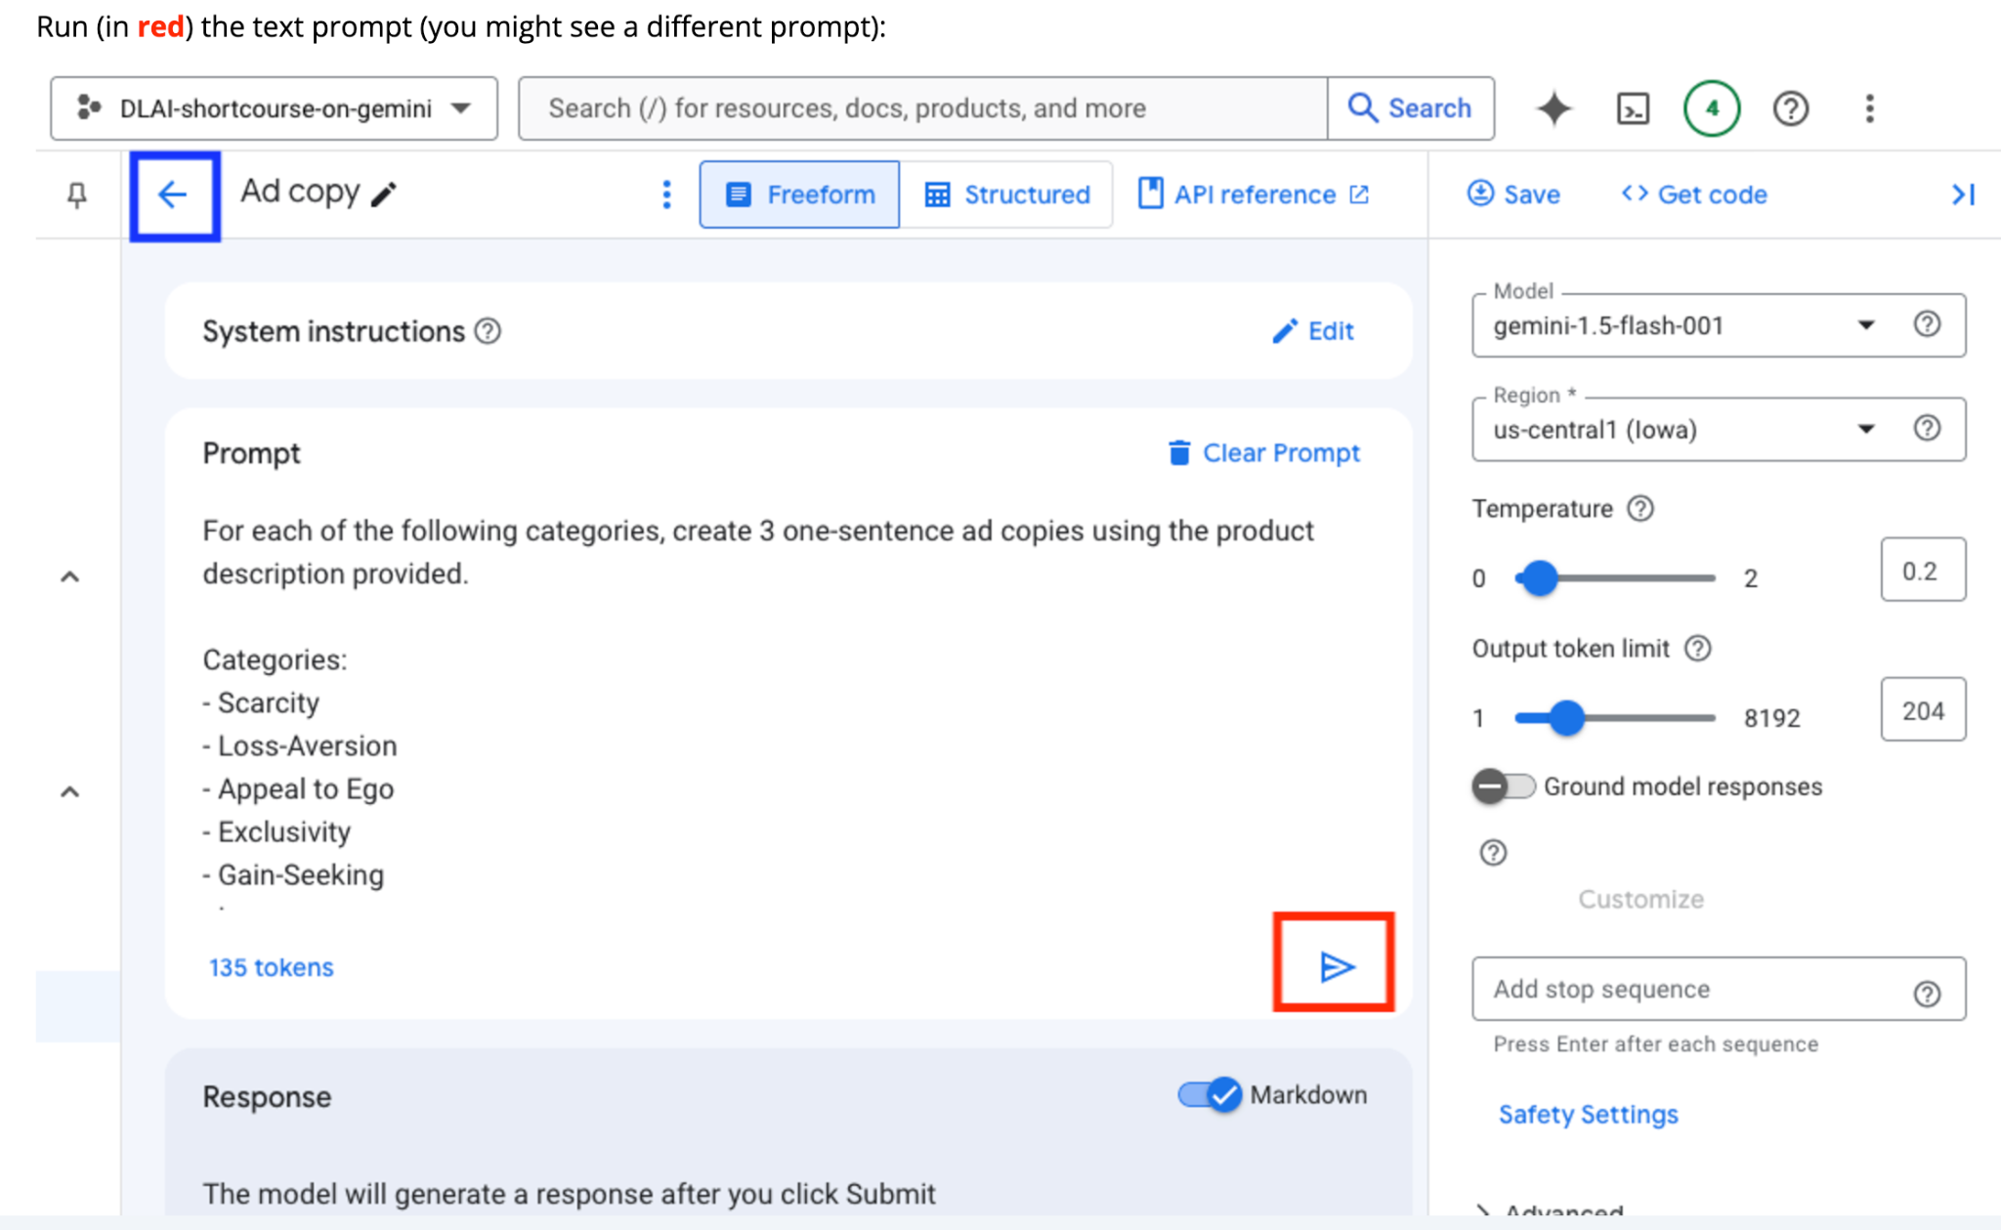
Setup Google Cloud
If your execution is successful, you should see a response without any errors.
Great!

Slide 79
Setup Google Cloud
If your execution is successful, you should see a response without any errors.
Great!

Slide 80
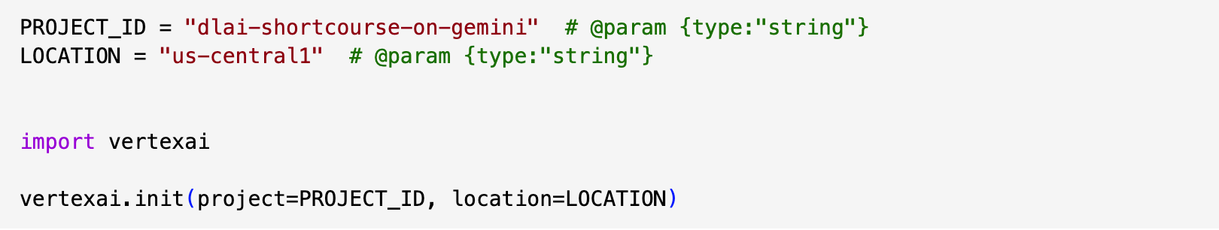
Setup Vertex AI API

Slide 81
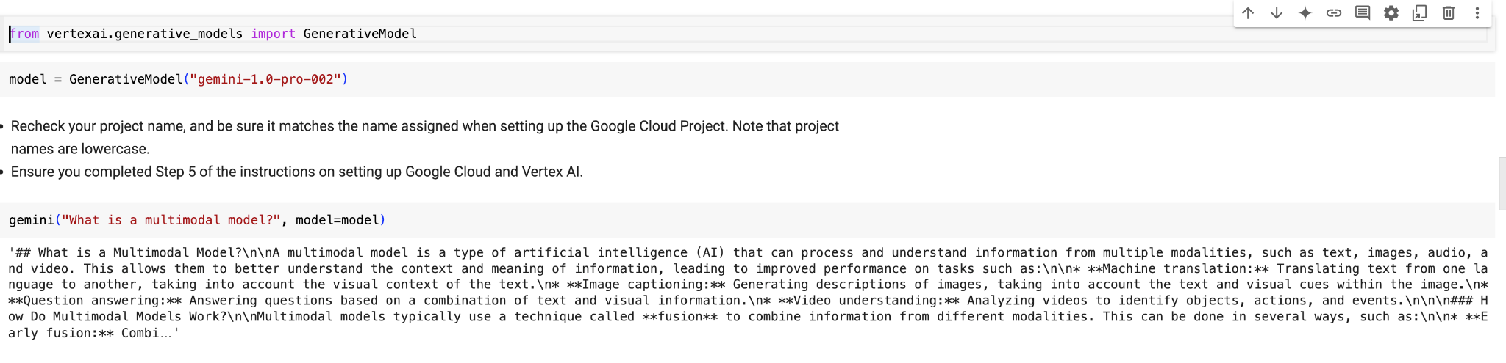
Multimodality: Text

Slide 82
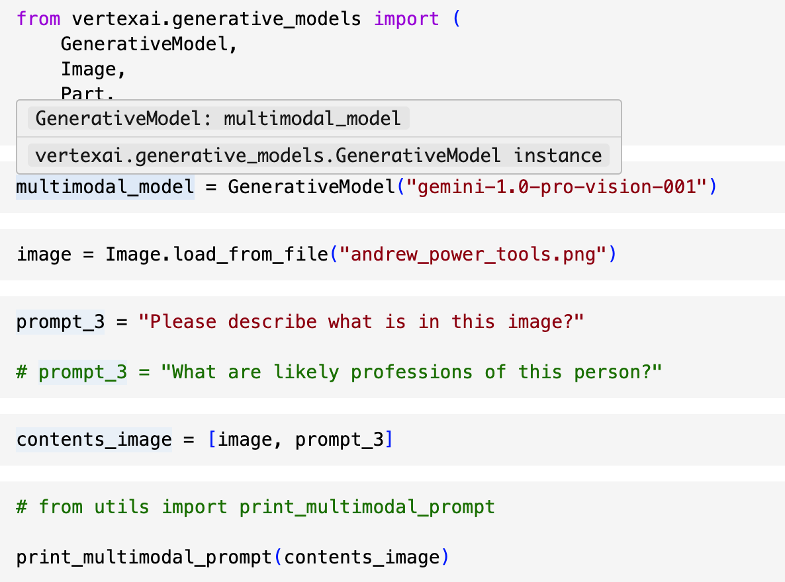

Multimodality: Image + Text

Slide 83

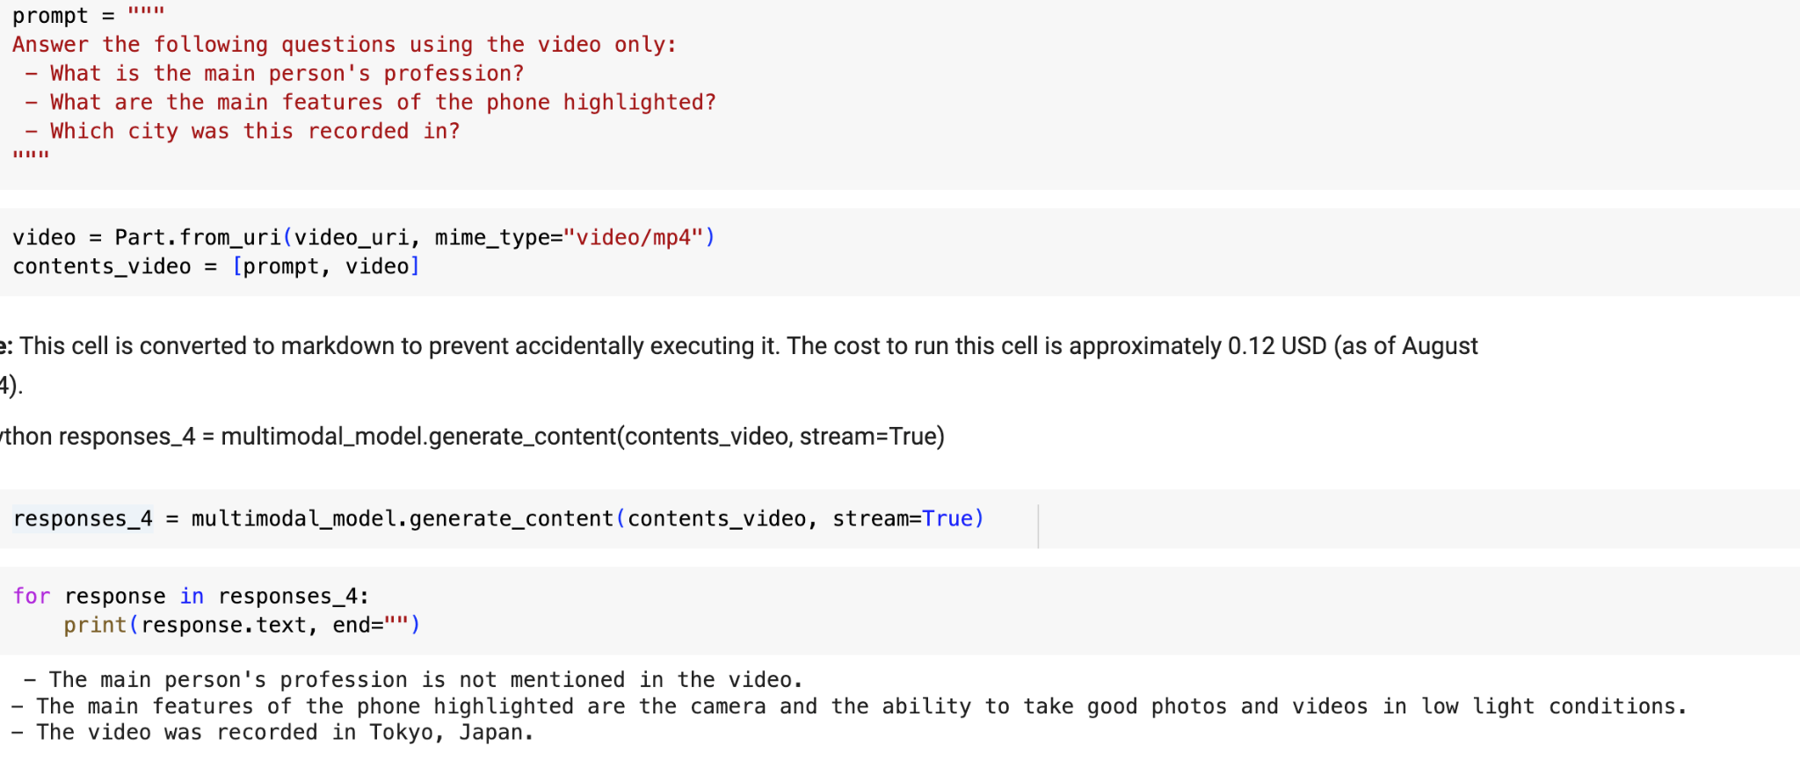
Multimodality: Video + Text

Slide 84

Default Parameter Values

Slide 85

Low Temperature and Top K

Slide 86

High Temperature and Top K

Slide 87

Top P

Slide 88

Max Output Tokens

Slide 89

Stop Sequences

Slide 90

Image Requirement
Image to tokens: Use up to 3000 images.
Image type: PNG or JPEG
Image pixels: The number of pixels in an image isn't limited. However, larger images are scaled down and padded.
Image to tokens: Each image accounts for 258 tokens

Slide 91

Be Clear and Concise

Slide 92

Assign a Role

Slide 93
Why does assigning a Role matter?
It provides clarity to the model.
It allows the model to focus on what you are asking it to do.
It encourages the model to maintain consistency throughout its output.

Slide 94

Structure a Prompt

Slide 95
Structure Prompts
A well-structured prompt does three key things:
Organizes Information
Guides Interpretation
Encourages Desired Output

Slide 96
Structure Prompts
Role: Clearly define the role you want the model to take on. This helps it understand its purpose and adjust its responses accordingly.
Objective: State the goal you want the model to achieve. This could be answering a question, summarizing a document, generating code, or providing insights.
Context: Provide any background information or relevant data the model needs to understand the task and generate accurate responses. This could include text, images, charts, or other data sources.
Constraints: Specify any limitations or requirements you want the model to adhere to. This might include the length of the response, the format of the output, or restrictions on certain types of content.

Slide 97

Order Can Matter

Slide 98

Order Can Matter
Why Order matters?
Contextual Understanding
Attention and Focus

Slide 99


Use Case 1 - Compute Cost of a fruit salad

Slide 100


Use Case 2 - Interior Design Recommendation

Slide 101


Use Case 3 - Compute Business Expense

Slide 102


Use Case 4 - Extract Video Information for Digital Marketeer

Slide 103


Use Case 5 - Explaining the Educational Concepts

Slide 104


Use case 6 - Extract Information form Video

Slide 105


Use Case 7 - Finding a Needle in a Haystack

Slide 106

Function Calling

Slide 107


Function Calling with LLM

Slide 108
Use Cases of Function Calling
Help customers interact with businesses: Create functions that connect to a business' API, allowing the model to provide accurate answers to queries such as "is product A still available?".
Build generative AI applications by connecting to public APIs: Get the weather for a given location. Create a function that connects to an API of a meteorological service, allowing the model to provide accurate answers to queries such as "What's the weather like in Paris?".

Slide 109
Topic 3
Building LLM Applications with LangChain and Gemini

Slide 110

Notes:
K5: Functions of Application Programming Interfaces (APIs)
A3: Utilise middleware to integrate data and functions across application programs within an enterprise
A4: Support API-level integration

Slide 111
LangChain
LangChain is a framework for developing applications powered by language models. It enables applications that:
Are context-aware: connect a language model to sources of context (prompt instructions, few shot examples, content to ground its response in, etc.)
Reason: rely on a language model to reason (about how to answer based on provided context, what actions to take, etc.)
Notes:
K5: Functions of Application Programming Interfaces (APIs)
A3: Utilise middleware to integrate data and functions across application programs within an enterprise
A4: Support API-level integration

Slide 112
LangChain Frameworks
LangChain Libraries: The Python and JavaScript libraries.
LangChain Templates: A collection of easily deployable reference architectures for a wide variety of tasks.
LangServe: A library for deploying LangChain chains as a REST API.
LangSmith: A developer platform that lets you debug, test, evaluate, and monitor chains built on any LLM framework and seamlessly integrates with LangChain.
Notes:
K5: Functions of Application Programming Interfaces (APIs)
A3: Utilise middleware to integrate data and functions across application programs within an enterprise
A4: Support API-level integration

Slide 113

Notes:
K5: Functions of Application Programming Interfaces (APIs)
A3: Utilise middleware to integrate data and functions across application programs within an enterprise
A4: Support API-level integration

Slide 114
LangChain Components
MODEL IO
DATA
CONNECTION
CHAINS
MEMORY
AGENTS
Notes:
K5: Functions of Application Programming Interfaces (APIs)
A3: Utilise middleware to integrate data and functions across application programs within an enterprise
A4: Support API-level integration

Slide 115
Model IO
Model IO focuses on basic LLM inputs and outputs. This replicates a lot of the functionality already present in default APIs, such as the OpenAI API.
Model IO is standardized, allowing you to easily switch between LLMs in the future and supports both Text Completion APIs and Chat Interface APIs
MODEL IO
Notes:
K5: Functions of Application Programming Interfaces (APIs)
A3: Utilise middleware to integrate data and functions across application programs within an enterprise
A4: Support API-level integration

Slide 116

Model I/O

Slide 117
Data Connection
Data Connection focuses on connecting an LLM Model to a data source, such as your own documents or a vector store.
Easily swap vector stores (ChromaDB).
Integrate with many different data sources to create standardized document objects from a variety of sources (CSVs, PDFs, AWS, Google Cloud, etc…).
DATA
CONNECTION
Notes:
K5: Functions of Application Programming Interfaces (APIs)
A3: Utilise middleware to integrate data and functions across application programs within an enterprise
A4: Support API-level integration

Slide 118

Vectorstores and Embedding

Slide 119

Retrieval
Notes:
https://python.langchain.com/docs/modules/memory/

Slide 120
Chains
Chains allows you to link the output of one model to be the input of another model call.
Easily chain together different LLM calls to separate out work between models, allowing you to swap LLMs in the middle of a chain easily.
CHAINS
Notes:
K5: Functions of Application Programming Interfaces (APIs)
A3: Utilise middleware to integrate data and functions across application programs within an enterprise
A4: Support API-level integration

Slide 121
Memory
Memory allows your models to retain historical context of previous interactions.
Easily save historical conversations or results from LLMs or Chat Models and reload them for future use.
MEMORY
Notes:
K5: Functions of Application Programming Interfaces (APIs)
A3: Utilise middleware to integrate data and functions across application programs within an enterprise
A4: Support API-level integration

Slide 122

Memory

Slide 123
Agents
Agents are the most powerful part of LangChain. Utilizing Models, Data Connections, Chains, and Memory, Agents can use tools to reason through requests and perform actions based on observational outputs.
Create agents and custom tools with just a few lines of code
AGENTS
Notes:
K5: Functions of Application Programming Interfaces (APIs)
A3: Utilise middleware to integrate data and functions across application programs within an enterprise
A4: Support API-level integration

Slide 124

Install LangChain
Notes:
A5: Perform tests and checks on the connections between disparate application programs

Slide 125

Configure the Model
Notes:
A5: Perform tests and checks on the connections between disparate application programs

Slide 126
Prompt Templates
Templates allow us to easily configure and modify our input prompts to LLM calls.
Templates offer a more systematic approach to passing in variables to prompts for models, instead of using f-string literals or .format() calls, the PromptTemplate converts these into function parameter names that we can pass in.
Notes:
A5: Perform tests and checks on the connections between disparate application programs
A4: Support API-level integration

Slide 127

Prompt Template
Notes:
A5: Perform tests and checks on the connections between disparate application programs

Slide 128

Prompt Template
Notes:
A5: Perform tests and checks on the connections between disparate application programs

Slide 129

Output Parser
Notes:
A5: Perform tests and checks on the connections between disparate application programs

Slide 130
Memory
Notes:
K3: Different types of platforms on which applications run
A5: Perform tests and checks on the connections between disparate application programs

Slide 131

Memory
Large Language Models are "stateless"
Each transaction is independent
Chatbots appear to have memory by providing the full conversation as "context". This can be expensive as API is charged by token input.
Langchain provides several kinds of memory to store and accumulate the conversation.
Notes:
K3: Different types of platforms on which applications run
A5: Perform tests and checks on the connections between disparate application programs

Slide 132
LangChain Memory
ConversationBufferMemory - This memory allows for storing of messages and then extracts the messages in a variable
ConversationBufferWindowMemory - This memory keeps on a list of the interactions of the conversation over time. It only uses the last k interactions
ConversationTokenBufferMemory - This memory keeps a buffer of recent interactions in the memory and uses token length rather than number of interactions to determine when to flush out interactions.
ConversationSummaryMemory - This memory creates a summary of the conversations over time.
Notes:
K3: Different types of platforms on which applications run
A5: Perform tests and checks on the connections between disparate application programs

Slide 133

ConversationBufferMemory
Notes:
K3: Different types of platforms on which applications run
A5: Perform tests and checks on the connections between disparate application programs

Slide 134

ConversationBufferWindowMemory
Notes:
K3: Different types of platforms on which applications run
A5: Perform tests and checks on the connections between disparate application programs

Slide 135

ConversationTokenBufferMemory
Notes:
K3: Different types of platforms on which applications run
A5: Perform tests and checks on the connections between disparate application programs

Slide 136

ConversationSummaryMemory
Notes:
K3: Different types of platforms on which applications run
A5: Perform tests and checks on the connections between disparate application programs

Slide 137
Chains
Notes:
K3: Different types of platforms on which applications run
A5: Perform tests and checks on the connections between disparate application programs

Slide 138
LangChain Chains
LLMChain
Sequential Chains
SimpleSequentialChain
SequentialChain
Router Chain
Notes:
K3: Different types of platforms on which applications run
A5: Perform tests and checks on the connections between disparate application programs

Slide 139

LLMChain
Notes:
K3: Different types of platforms on which applications run
A5: Perform tests and checks on the connections between disparate application programs

Slide 140

Sequential Chain
Sequential Chains is another type of chains
The idea is to combine multiple chains where the output of one chain is the input to the next chain.
There are two types of sequential chains
SimpleSequentialChain - single input/output
SequentialChain - multiple inputs/outpus
Notes:
K3: Different types of platforms on which applications run
A5: Perform tests and checks on the connections between disparate application programs

Slide 141

SimpleSequentialChain
Notes:
K3: Different types of platforms on which applications run
A5: Perform tests and checks on the connections between disparate application programs

Slide 142

SimpleSequentialChain
Notes:
K3: Different types of platforms on which applications run
A5: Perform tests and checks on the connections between disparate application programs

Slide 143

Activity: SimpleSequentialChain
Notes:
K3: Different types of platforms on which applications run
A5: Perform tests and checks on the connections between disparate application programs

Slide 144

SequentialChain
Notes:
K3: Different types of platforms on which applications run
A5: Perform tests and checks on the connections between disparate application programs

Slide 145

SequentialChain
Notes:
K3: Different types of platforms on which applications run
A5: Perform tests and checks on the connections between disparate application programs

Slide 146

Activity: SequentialChain
Notes:
K3: Different types of platforms on which applications run
A5: Perform tests and checks on the connections between disparate application programs

Slide 147

Router Chain
Notes:
K3: Different types of platforms on which applications run
A5: Perform tests and checks on the connections between disparate application programs

Slide 148
LLMRouterChains
LLMRouterChains can take in an input and redirect it to the most appropriate LLMChain sequence.
Customer Support
LLMChain
Input
LLMRouter
Internal Employees
LLMChain
Notes:
K5: Functions of Application Programming Interfaces (APIs)
A3: Utilise middleware to integrate data and functions across application programs within an enterprise
A4: Support API-level integration

Slide 149


Router Chain
Notes:
K3: Different types of platforms on which applications run
A5: Perform tests and checks on the connections between disparate application programs

Slide 150

Router Chain
Notes:
K3: Different types of platforms on which applications run
A5: Perform tests and checks on the connections between disparate application programs

Slide 151

Router Chain
Notes:
K3: Different types of platforms on which applications run
A5: Perform tests and checks on the connections between disparate application programs

Slide 152

Router Chain
Notes:
K3: Different types of platforms on which applications run
A5: Perform tests and checks on the connections between disparate application programs

Slide 153

Activity: Router Chain
Create a Router Chain use case
Share with the class
Notes:
K3: Different types of platforms on which applications run
A5: Perform tests and checks on the connections between disparate application programs

Slide 154
Agents
Notes:
K3: Different types of platforms on which applications run
A6: Verify proper functioning of modules and applications across multiple or integrated platform

Slide 155
Tools
Tools are functions that an agent can invoke.
Using built in LangChain tools:
DuckDuckGo search
Wikipedia
Defining your own tools
Notes:
K3: Different types of platforms on which applications run
A6: Verify proper functioning of modules and applications across multiple or integrated platform

Slide 156

LangChain Tools
Explore the various Langchain built-in tools here https://python.langchain.com/docs/integrations/tools
Notes:
K3: Different types of platforms on which applications run
A6: Verify proper functioning of modules and applications across multiple or integrated platform

Slide 157
Agents
In LangChain’s implementation, this takes the form of an Agent that has access to a list of tools.
The Agent is given a task and can reason which tools are appropriate to use and can then utilize those results to continue on via an internal chain until it solves the task.
Internally LangChain labels the thinking in terms of Observation, Thought, and Action.
Notes:
K3: Different types of platforms on which applications run
A6: Verify proper functioning of modules and applications across multiple or integrated platform

Slide 158

ReACT
At their core, agents allow LLMs to connect to tools (e.g. Wikipedia, Calculator, Google Search, etc…) and conduct a structured approach to complete a task based on ReAct: Reasoning and Acting.
Notes:
K3: Different types of platforms on which applications run
A6: Verify proper functioning of modules and applications across multiple or integrated platform

Slide 159

ReAct
ReAct prompting can help an LLM reason about a task and perform correct actions based on observations:
Notes:
K3: Different types of platforms on which applications run
A6: Verify proper functioning of modules and applications across multiple or integrated platform
A4: Support API-level integration

Slide 160

Example of ReACT
Notes:
K3: Different types of platforms on which applications run
A6: Verify proper functioning of modules and applications across multiple or integrated platform
A4: Support API-level integration

Slide 161

Create Agent (Math, Wikipedia)
Notes:
K3: Different types of platforms on which applications run
A6: Verify proper functioning of modules and applications across multiple or integrated platform

Slide 162

Create Agent (Math, Wikipedia)
Notes:
K3: Different types of platforms on which applications run
A6: Verify proper functioning of modules and applications across multiple or integrated platform

Slide 163

Create Agent (Math, Wikipedia)
Notes:
K3: Different types of platforms on which applications run
A6: Verify proper functioning of modules and applications across multiple or integrated platform

Slide 164

Create Agent (Search, Summarize)
Notes:
K3: Different types of platforms on which applications run
A6: Verify proper functioning of modules and applications across multiple or integrated platform

Slide 165

Activity: Create Agent
Notes:
K3: Different types of platforms on which applications run
A5: Perform tests and checks on the connections between disparate application programs

Slide 166

Agent - Define Your Own Tool
Notes:
K3: Different types of platforms on which applications run
A6: Verify proper functioning of modules and applications across multiple or integrated platform

Slide 167

Agent - Define Your Own Tool
Notes:
K3: Different types of platforms on which applications run
A6: Verify proper functioning of modules and applications across multiple or integrated platform

Slide 168

Conversational Agent
Notes:
K3: Different types of platforms on which applications run
A6: Verify proper functioning of modules and applications across multiple or integrated platform

Slide 169
Group Activity: Agent
Form a group of 3-5pax
Create your own Agent with 3 or more tools
Share the findings with the class
Notes:
K3: Different types of platforms on which applications run
A5: Perform tests and checks on the connections between disparate application programs

Slide 170
Topic 4
Implementing Retrieval Augmented Generation (RAG)
Notes:
Introduction to the AI and Prompt Engineering
Prompt engineering principles and tactics
Conceptualize content ideas to meet marketing objectives using Prompt Engineering
Map out digital storyboards as part of a content strategy

Slide 171

Retrieval Augmented Generation (RAG)
Notes:
https://python.langchain.com/docs/modules/memory/

Slide 172
Document Loading
Notes:
A6: Verify proper functioning of modules and applications across multiple or integrated platforms

Slide 173
Loaders
Loaders deal with the specifics of accessing and converting data
Accessing
Websites
Databases
Youtube
arXiv
….
Data types
PDF
HTML
JSON
Word, Powerpoint….
Returns a list of document objects
Notes:
https://python.langchain.com/docs/modules/memory/

Slide 174

CSV
Notes:
K3: Different types of platforms on which applications run
A6: Verify proper functioning of modules and applications across multiple or integrated platform

Slide 175

HTML
Notes:
K3: Different types of platforms on which applications run
A6: Verify proper functioning of modules and applications across multiple or integrated platform

Slide 176

URL
Notes:
K3: Different types of platforms on which applications run
A6: Verify proper functioning of modules and applications across multiple or integrated platform

Slide 177

PDF
Notes:
K3: Different types of platforms on which applications run
A6: Verify proper functioning of modules and applications across multiple or integrated platform

Slide 178
Document Splitting
Notes:
A6: Verify proper functioning of modules and applications across multiple or integrated platforms

Slide 179

Recursive Splitting for Simple Text

Slide 180

Recursive Splitting for Multiple Files

Slide 181

Document Embedding

Slide 182
Storage:
Text Embedding and Vector Store
Notes:
K3: Different types of platforms on which applications run
A5: Perform tests and checks on the connections between disparate application programs

Slide 183

Embedding
Notes:
K3: Different types of platforms on which applications run
A5: Perform tests and checks on the connections between disparate application programs

Slide 184

Embedding
Notes:
K3: Different types of platforms on which applications run
A5: Perform tests and checks on the connections between disparate application programs

Slide 185

Embedding
Notes:
K3: Different types of platforms on which applications run
A5: Perform tests and checks on the connections between disparate application programs

Slide 186

Vector Database
Notes:
K3: Different types of platforms on which applications run
A5: Perform tests and checks on the connections between disparate application programs

Slide 187
Vector Stores
Chroma
FAISS
Milvus
Pinecone
Notes:
https://js.langchain.com/docs/integrations/vectorstores

Slide 188

Chroma
Notes:
https://js.langchain.com/docs/integrations/vectorstores

Slide 189

Upload Data to Chroma
Notes:
K3: Different types of platforms on which applications run
A5: Perform tests and checks on the connections between disparate application programs

Slide 190

Activity: Text Embedding and Vector Store
Notes:
K3: Different types of platforms on which applications run
A5: Perform tests and checks on the connections between disparate application programs

Slide 191

Vector DBs + Semantic Search
Notes:
K3: Different types of platforms on which applications run
A5: Perform tests and checks on the connections between disparate application programs

Slide 192

Semantic Search
Notes:
K3: Different types of platforms on which applications run
A5: Perform tests and checks on the connections between disparate application programs

Slide 193

Semantic Search
Notes:
K3: Different types of platforms on which applications run
A5: Perform tests and checks on the connections between disparate application programs

Slide 194

Simple Similarity Search
Notes:
https://js.langchain.com/docs/integrations/vectorstores

Slide 195

Maximum Marginal Relevance (MMR)
Notes:
https://python.langchain.com/docs/modules/memory/

Slide 196

Similarity Search vs MMR
Notes:
https://python.langchain.com/docs/modules/memory/

Slide 197

MMR Search

Slide 198
Retrieval
Notes:
A6: Verify proper functioning of modules and applications across multiple or integrated platforms

Slide 199

Retrieval
Notes:
Vector stores | 🦜️🔗 Langchain

Slide 200

Retrieval
Notes:
K3: Different types of platforms on which applications run
A5: Perform tests and checks on the connections between disparate application programs

Slide 201
Retrieval Augmented Generation (RAG)
Notes:
A6: Verify proper functioning of modules and applications across multiple or integrated platforms

Slide 202

Retrieval Augmented Generation (RAG)
Notes:
A1: Identify opportunities for creating connections among various devices, databases, software and applications

Slide 203

Retrieval Augmented Generation (RAG)
Notes:
A1: Identify opportunities for creating connections among various devices, databases, software and applications

Slide 204
Use Cases of RAG
Question Answering
Information Retrieval
Content Recommendation
Data Enrichment
Knowledge Base Construction
Academic Research
Legal Research
Language Translation
Customer Support
Educational Tools
Notes:
A1: Identify opportunities for creating connections among various devices, databases, software and applications

Slide 205

RetrievalQA RAG
Notes:
Vector stores | 🦜️🔗 Langchain

Slide 206

RetrievalQA RAG
Notes:
K3: Different types of platforms on which applications run
A6: Verify proper functioning of modules and applications across multiple or integrated platform

Slide 207

ConversationalRetrievalChain
Notes:
Vector stores | 🦜️🔗 Langchain

Slide 208

ConversationalRetrievalChain

Slide 209
Group Activity: RAG
Form a group of 3-5pax
Create a RAG using your own documents
Share the findings with the class
Notes:
K3: Different types of platforms on which applications run
A5: Perform tests and checks on the connections between disparate application programs

Slide 210
Summary
Q&A

Slide 211

Digital Attendance
It is mandatory for you to take both AM and PM digital attendance especially for WSQ courses.
The trainer or administrator will show you the digital attendance QR code generated from TPG.
Please scan the QR code from your Singpass App and submit your attendance.

Slide 212
Final
Assessment
Notes:
Assessor Guide:
Request the access to
https://colab.research.google.com/drive/1Z3GWKczCULhG6Gd86vvYbykwCqjcUIn9?usp=sharing

Slide 213

TRAQOM Survey
Access the survey here
Key in your Last four NRIC/FIN characters and the Six-digit course run ID to complete the survey

Slide 214

Feedback
Kindly submit your course feedback below
https://goo.gl/R2eumq

Slide 215
Support
If you have any enquiries during and after the class, you can contact us below
Email: enquiry@tertiaryinfotech.com
Tel: 61000613
Whatsapp: 61000613

Slide 216
Thank You!

